Slide 1
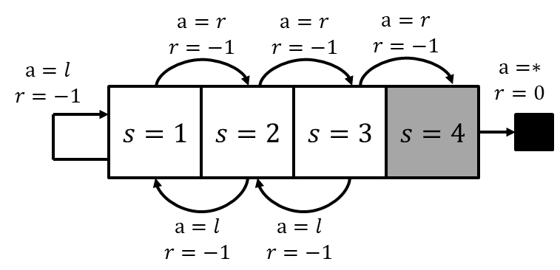






L7.2.X Worked Examples
Zonghua Gu 2021
C
$$a1, r=1$$
$$a1, r=1$$
B
$$a2, r=3$$
T
$a1, r=$-100
$$a2, r=0$$
D
$$a2, r=4$$
Notes:
https://blog.floydhub.com/an-introduction-to-q-learning-reinforcement-learning/

Slide 2
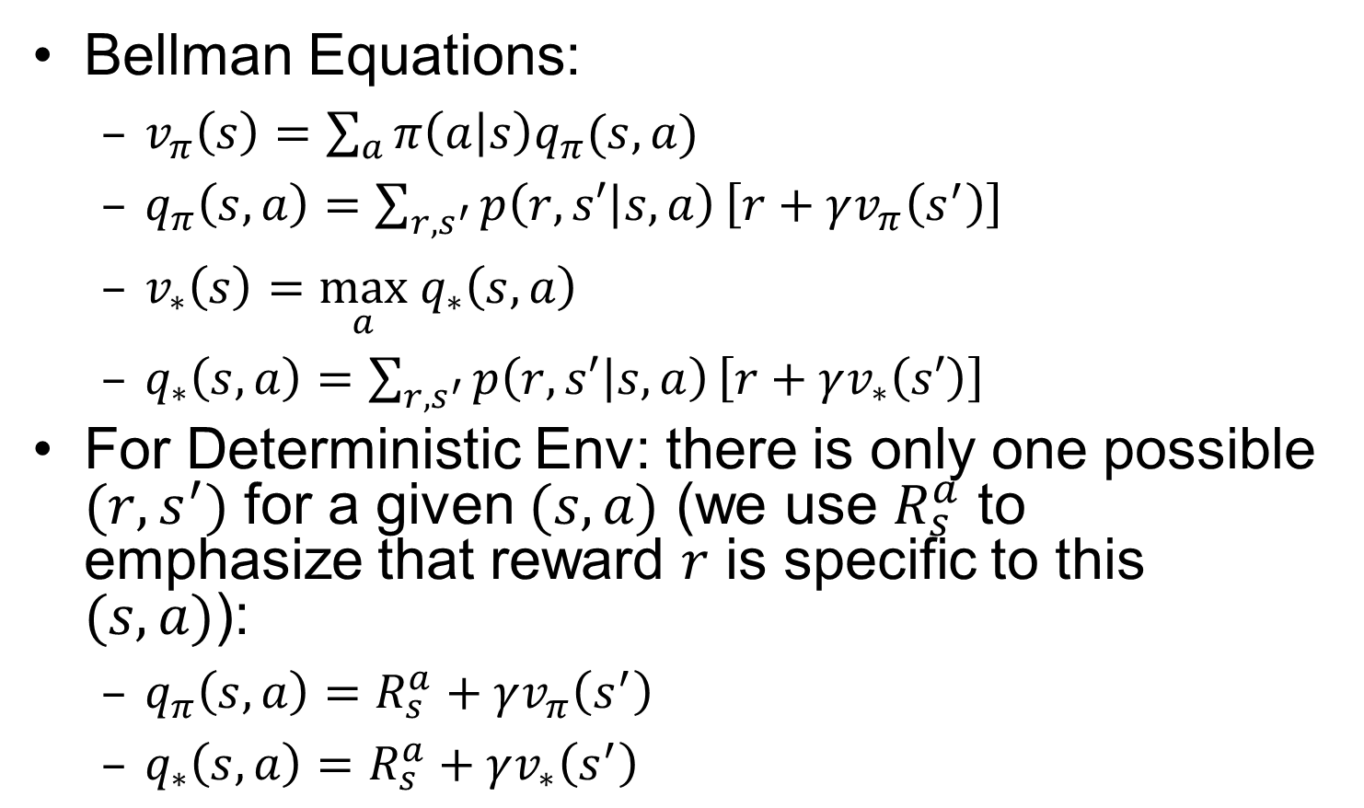
Recall: Simplified Bellman Equations for Deterministic Env
Bellman Equations:
$v_{π}\left(s\right)=\sum_{a}{π\left(a | s\right)q_{π}(s,a)}$
$q_{π}\left(s,a\right)=\sum_{{r, s}^{′}}{p\left(r,s′ | s,a\right)}\left[r+γv_{π}\left(s^{′}\right)\right]$
$v_{∗}\left(s\right)=\max_{a} q_{∗}\left(s,a\right)$
$q_{∗}\left(s,a\right)=\sum_{{r, s}^{′}}{p\left(r,s′ | s,a\right)}\left[r+γv_{∗}\left(s′\right)\right]$
For Deterministic Env: there is only one possible $(r,s^{′})$ for a given $(s,a)$ (we use $R_{s}^{a}$ to emphasize that reward $r$ is specific to this $(s,a)$):
$q_{π}\left(s,a\right)=R_{s}^{a}+γv_{π}\left(s^{′}\right)$
$q_{∗}\left(s,a\right)=R_{s}^{a}+γv_{∗}\left(s^{′}\right)$

Slide 3
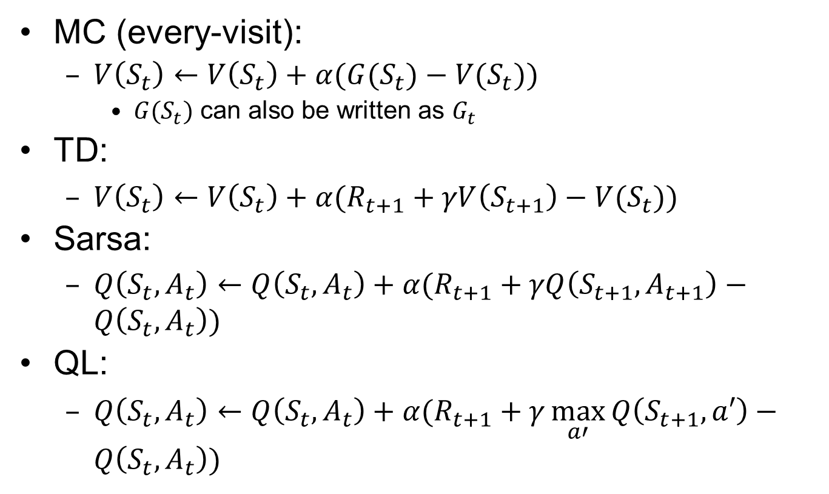
Recall: MC, TD, Sarsa, Q Learning
MC (every-visit):
$V\left(S_{t}\right)←V\left(S_{t}\right)+α(G(S_{t})−V(S_{t}))$
$G(S_{t})$ can also be written as $G_{t}$
TD:
$V\left(S_{t}\right)←V\left(S_{t}\right)+α(R_{t+1}+γV\left(S_{t+1}\right)−V(S_{t}))$
Sarsa:
$Q\left(S_{t},A_{t}\right)←Q\left(S_{t},A_{t}\right)+α(R_{t+1}+γQ\left(S_{t+1},A_{t+1}\right)−Q\left(S_{t},A_{t}\right))$
QL:
$Q\left(S_{t},A_{t}\right)←Q\left(S_{t},A_{t}\right)+α(R_{t+1}+γ\max_{a′}{Q\left(S_{t+1},a′\right)}−Q\left(S_{t},A_{t}\right))$

Slide 4

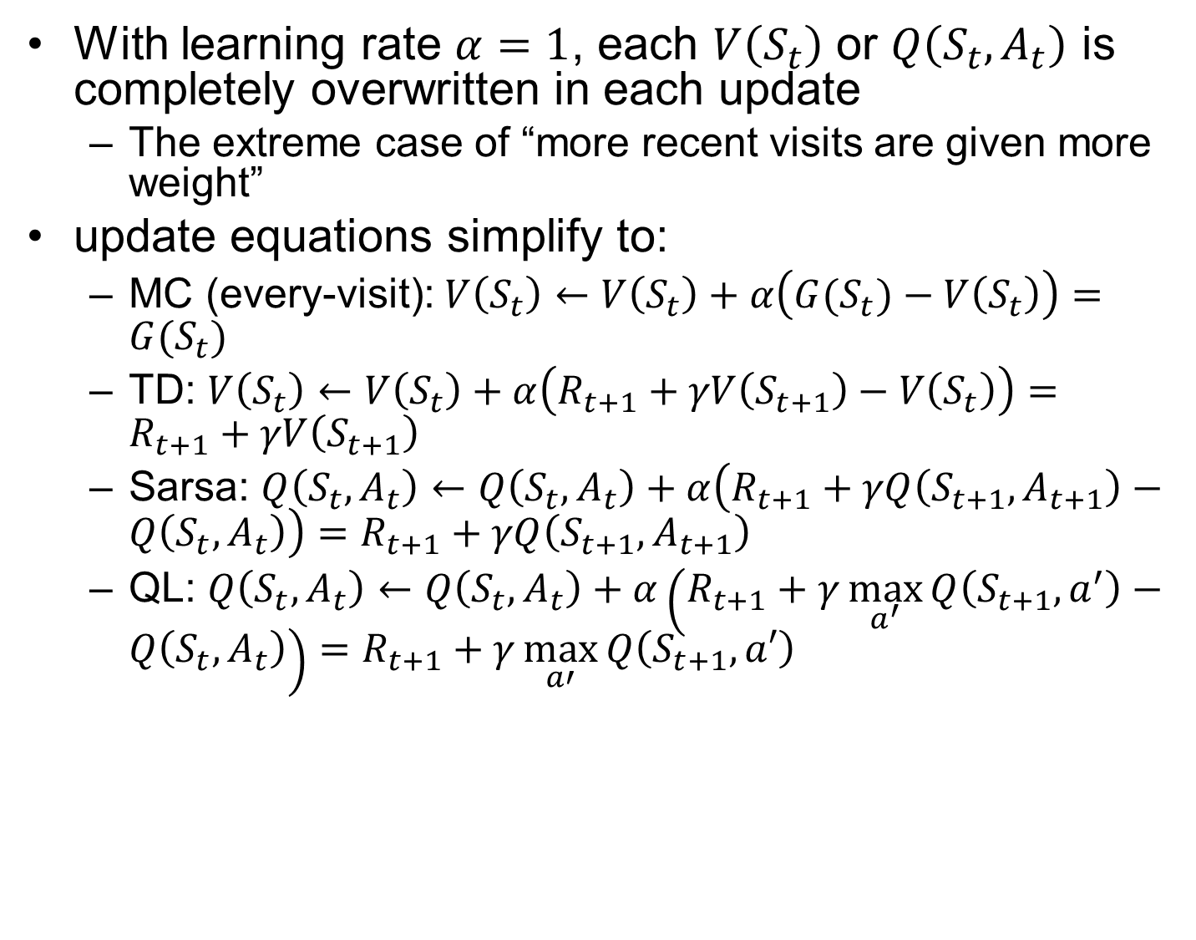
MC, TD, Sarsa, QL w. $α=1$
With learning rate $α=1$, each $V\left(S_{t}\right)$ or $Q\left(S_{t},A_{t}\right)$ is completely overwritten in each update
The extreme case of “more recent visits are given more weight”
update equations simplify to:
MC (every-visit): $V\left(S_{t}\right)←V\left(S_{t}\right)+α\left(G(S_{t})−V\left(S_{t}\right)\right)=G(S_{t})$
TD: $V\left(S_{t}\right)←V\left(S_{t}\right)+α\left(R_{t+1}+γV\left(S_{t+1}\right)−V\left(S_{t}\right)\right)=R_{t+1}+γV\left(S_{t+1}\right)$
Sarsa: $Q\left(S_{t},A_{t}\right)←Q\left(S_{t},A_{t}\right)+α\left(R_{t+1}+γQ\left(S_{t+1},A_{t+1}\right)−Q\left(S_{t},A_{t}\right)\right)=R_{t+1}+γQ\left(S_{t+1},A_{t+1}\right)$
QL: $Q\left(S_{t},A_{t}\right)←Q\left(S_{t},A_{t}\right)+α\left(R_{t+1}+γ\max_{a^{′}}{Q\left(S_{t+1},a^{′}\right)}−Q\left(S_{t},A_{t}\right)\right)=R_{t+1}+γ\max_{a′}{Q\left(S_{t+1},a′\right)}$
Notes:
Bellman Equations for Deterministic Env :
$$v_{π}\left(s\right)=\sum_{a}{π\left(a | s\right)q_{π}(s,a)};q_{π}\left(s,a\right)=R_{s}^{a}+γv_{π}\left(s^{′}\right)$$
$$v_{∗}\left(s\right)=\max_{a} q_{∗}\left(s,a\right);q_{∗}\left(s,a\right)=R_{s}^{a}+γv_{∗}\left(s^{′}\right)$$

Slide 5
Two-Branch Example

Slide 6
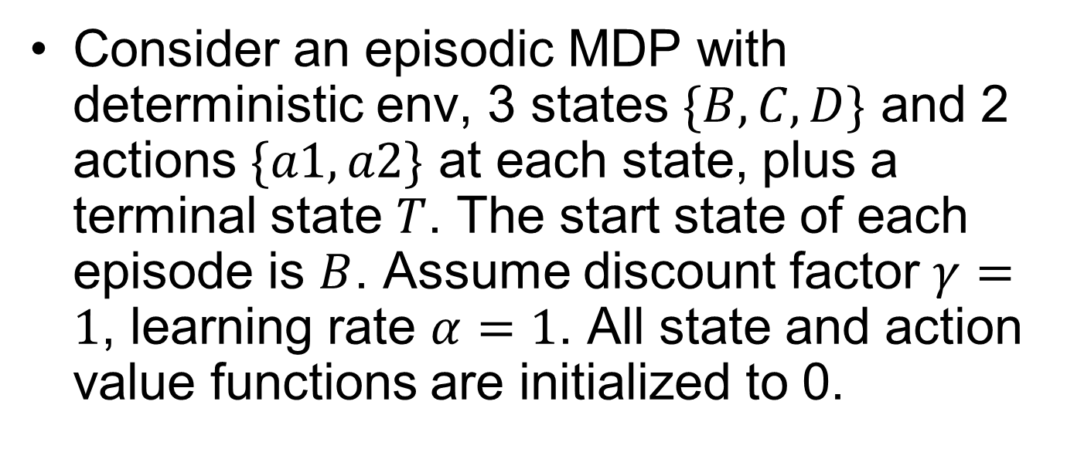

Two-Branch Example
Consider an episodic MDP with deterministic env, 3 states $\{B,C,D\}$ and 2 actions $\{a1,a2\}$ at each state, plus a terminal state $T$. The start state of each episode is $B$. Assume discount factor $γ=1$, learning rate $α=1$. All state and action value functions are initialized to 0.
C
$$a1, r=1$$
$$a1, r=1$$
B
$$a2, r=3$$
T
$$T$$
$a1, r=$-100
$$a2, r=0$$
D
$$a2, r=4$$
Notes:
Consider TD, Sarsa and QL for different episodes. From state $D$ taking action $a=1$ leads to terminal state $T$ w. reward $−100$; From state $D$ taking action $a=2$ leads to terminal state $T$ w. reward $+4$.
From states $C$ and $D$, different actions lead to the terminal state $T$ w. different rewards
We are only concerned with the lower branch here

Slide 7
Policy Iteration

Slide 8
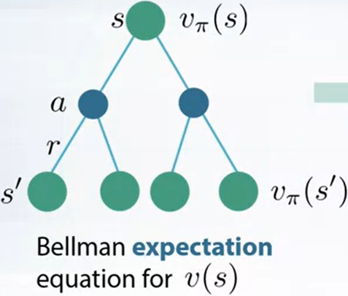
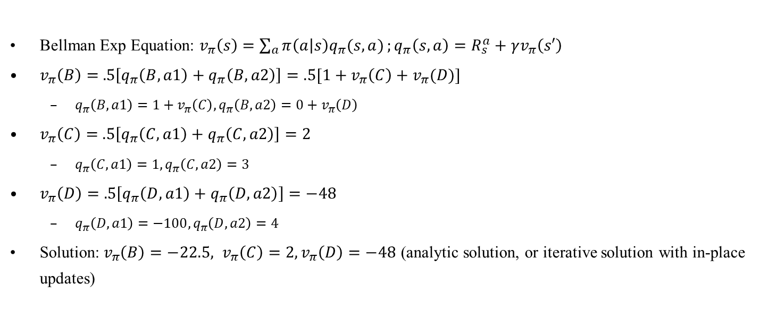
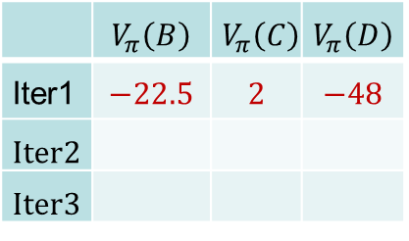
1.1 Policy Evaluation of Random Policy
BF=2
BF=1
Bellman Exp Equation: $v_{π}\left(s\right)=\sum_{a}{π\left(a | s\right)q_{π}(s,a)};q_{π}\left(s,a\right)=R_{s}^{a}+γv_{π}\left(s′\right)$
$v_{π}\left(B\right)=$ $.5\left[q_{π}\left(B,a1\right)+q_{π}\left(B,a2\right)\right]=.5[1+v_{π}\left(C\right)+v_{π}(D)]$
$q_{π}\left(B,a1\right)=1+v_{π}\left(C\right),q_{π}\left(B,a2\right)=0+v_{π}\left(D\right)$
$v_{π}\left(C\right)=$ $.5\left[q_{π}\left(C,a1\right)+q_{π}\left(C,a2\right)\right]=2$
$q_{π}\left(C,a1\right)=1, q_{π}\left(C,a2\right)=3$
$v_{π}\left(D\right)=$ $.5\left[q_{π}\left(D,a1\right)+q_{π}\left(D,a2\right)\right]=−48$
$q_{π}\left(D,a1\right)=−100, q_{π}\left(D,a2\right)=4$
Solution:$v_{π}\left(B\right)=−22.5, v_{π}\left(C\right)=2, v_{π}\left(D\right)=−48$ (analytic solution, or iterative solution with in-place updates)
C
$$a1, r=1$$
$$a1, r=1$$
2
 | $$V_{π}\left(B\right)$$ | $$V_{π}\left(C\right)$$ | $$V_{π}\left(D\right)$$
Iter1 | $$−22.5$$ | $$2$$ | $$−48$$
Iter2
Iter3
B
$$a2, r=3$$
T
-22.5
$a1, r=$-100
$$a2, r=0$$
D
$$a2, r=4$$
-48

Slide 9

1.2 Policy Improvement
Plug in values from PE to get new policy
$π^{′}\left(B\right)={argmax}_{a}\left(q_{π}\left(B,a1\right),q_{π}\left(B,a2\right)\right)=a1$
$q_{π}\left(B,a1\right)=1+v_{π}\left(C\right)=3, q_{π}\left(B,a2\right)=0+v_{π}\left(D\right)=−22.5$
$π^{′}\left(C\right)={argmax}_{a}\left(q_{π}\left(C,a1\right),q_{π}\left(C,a2\right)\right)=a2$
$q_{π}\left(C,a1\right)=1,q_{π}\left(C,a2\right)=3$
$π^{′}\left(D\right)={argmax}_{a}\left(q_{π}\left(D,a1\right),q_{π}\left(D,a2\right)\right)=a2$
$q_{π}\left(C,a1\right)=−100,q_{π}\left(C,a2\right)=4$
C
$$a1, r=1$$
$$a1, r=1$$
2
B
$$a2, r=3$$
T
-22.5
$a1, r=$-100
$$a2, r=0$$
D
$$a2, r=4$$
-48

Slide 10
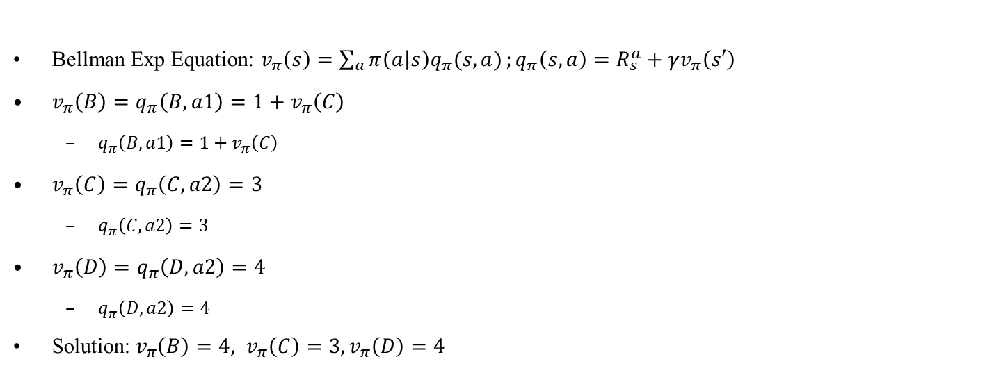
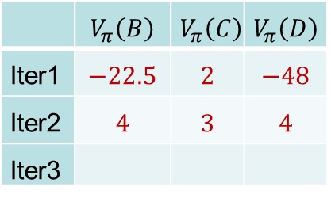
2.1 Policy Evaluation of Det Policy
BF=1
BF=1
Bellman Exp Equation: $v_{π}\left(s\right)=\sum_{a}{π\left(a | s\right)q_{π}(s,a)};q_{π}\left(s,a\right)=R_{s}^{a}+γv_{π}\left(s′\right)$
$v_{π}\left(B\right)=q_{π}\left(B,a1\right)=1+v_{π}\left(C\right)$
$q_{π}\left(B,a1\right)=1+v_{π}\left(C\right)$
$v_{π}\left(C\right)=q_{π}\left(C,a2\right)=3$
$q_{π}\left(C,a2\right)=3$
$v_{π}\left(D\right)=q_{π}\left(D,a2\right)=4$
$q_{π}\left(D,a2\right)=4$
Solution:$v_{π}\left(B\right)=4, v_{π}\left(C\right)=3, v_{π}\left(D\right)=4$
C
$$a1, r=1$$
$$a1, r=1$$
3
 | $$V_{π}\left(B\right)$$ | $$V_{π}\left(C\right)$$ | $$V_{π}\left(D\right)$$
Iter1 | $$−22.5$$ | $$2$$ | $$−48$$
Iter2 | $$4$$ | $$3$$ | $$4$$
Iter3
B
$$a2, r=3$$
T
4
$a1, r=$-100
$$a2, r=0$$
D
$$a2, r=4$$
4

Slide 11

2.2 Policy Improvement
Plug in values from PE to get new policy
$π^{′}\left(B\right)={argmax}_{a}\left(q_{π}\left(B,a1\right),q_{π}\left(B,a2\right)\right)=a1$ or $a2$
$q_{π}\left(B,a1\right)=1+v_{π}\left(C\right)=4, q_{π}\left(B,a2\right)=0+v_{π}\left(D\right)=4$
$π^{′}\left(C\right)={argmax}_{a}\left(q_{π}\left(C,a1\right),q_{π}\left(C,a2\right)\right)=a2$
$q_{π}\left(C,a1\right)=1,q_{π}\left(C,a2\right)=3$
$π^{′}\left(D\right)={argmax}_{a}\left(q_{π}\left(D,a1\right),q_{π}\left(D,a2\right)\right)=a2$
$q_{π}\left(C,a1\right)=−100,q_{π}\left(C,a2\right)=4$
C
$$a1, r=1$$
$$a1, r=1$$
3
B
$$a2, r=3$$
T
4
$a1, r=$-100
$$a2, r=0$$
D
$$a2, r=4$$
4

Slide 12
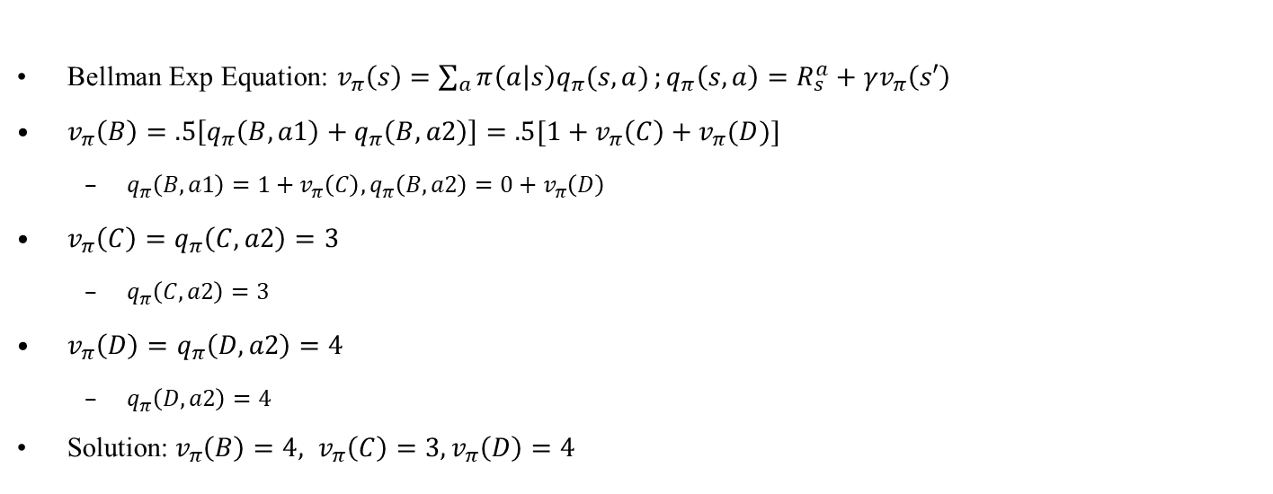
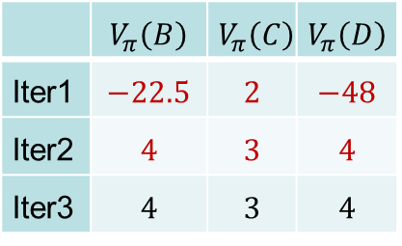
3.1 Policy Evaluation
BF=1 or 2
BF=1
Bellman Exp Equation: $v_{π}\left(s\right)=\sum_{a}{π\left(a | s\right)q_{π}(s,a)};q_{π}\left(s,a\right)=R_{s}^{a}+γv_{π}\left(s′\right)$
$v_{π}\left(B\right)=.5\left[q_{π}\left(B,a1\right)+q_{π}\left(B,a2\right)\right]=.5[1+v_{π}\left(C\right)+v_{π}(D)]$
$q_{π}\left(B,a1\right)=1+v_{π}\left(C\right),q_{π}\left(B,a2\right)=0+v_{π}\left(D\right)$
$v_{π}\left(C\right)=q_{π}\left(C,a2\right)=3$
$q_{π}\left(C,a2\right)=3$
$v_{π}\left(D\right)=q_{π}\left(D,a2\right)=4$
$q_{π}\left(D,a2\right)=4$
Solution:$v_{π}\left(B\right)=4, v_{π}\left(C\right)=3, v_{π}\left(D\right)=4$
C
$$a1, r=1$$
$$a1, r=1$$
3
 | $$V_{π}\left(B\right)$$ | $$V_{π}\left(C\right)$$ | $$V_{π}\left(D\right)$$
Iter1 | $$−22.5$$ | $$2$$ | $$−48$$
Iter2 | $$4$$ | $$3$$ | $$4$$
Iter3 | $$4$$ | $$3$$ | $$4$$
B
$$a2, r=3$$
T
4
$a1, r=$-100
$$a2, r=0$$
D
$$a2, r=4$$
4

Slide 13
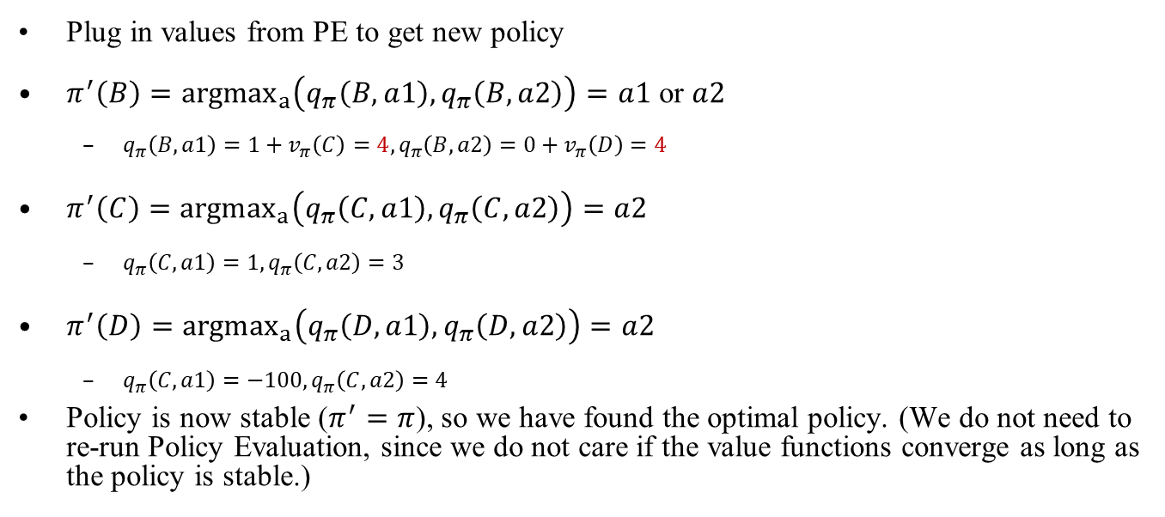
3.2 Policy Improvement
Plug in values from PE to get new policy
$π^{′}\left(B\right)={argmax}_{a}\left(q_{π}\left(B,a1\right),q_{π}\left(B,a2\right)\right)=a1$ or $a2$
$q_{π}\left(B,a1\right)=1+v_{π}\left(C\right)=4, q_{π}\left(B,a2\right)=0+v_{π}\left(D\right)=4$
$π^{′}\left(C\right)={argmax}_{a}\left(q_{π}\left(C,a1\right),q_{π}\left(C,a2\right)\right)=a2$
$q_{π}\left(C,a1\right)=1,q_{π}\left(C,a2\right)=3$
$π^{′}\left(D\right)={argmax}_{a}\left(q_{π}\left(D,a1\right),q_{π}\left(D,a2\right)\right)=a2$
$q_{π}\left(C,a1\right)=−100,q_{π}\left(C,a2\right)=4$
Policy is now stable ($π^{′}=π$), so we have found the optimal policy. (We do not need to re-run Policy Evaluation, since we do not care if the value functions converge as long as the policy is stable.)
C
$$a1, r=1$$
$$a1, r=1$$
3
B
$$a2, r=3$$
T
4
$a1, r=$-100
$$a2, r=0$$
D
$$a2, r=4$$
4

Slide 14
Value Iteration

Slide 15
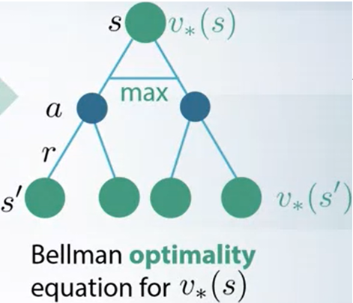
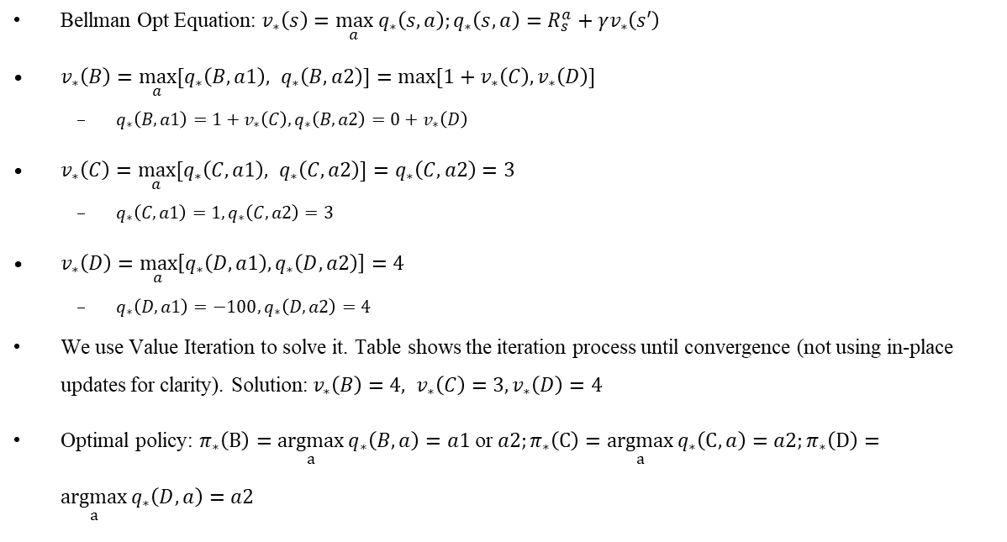

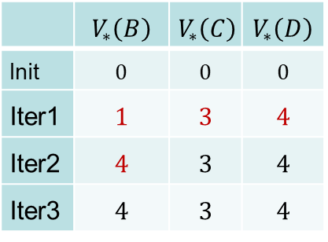
Value Iteration
BF=2
Bellman Opt Equation: $v_{∗}\left(s\right)=\max_{a} q_{∗}\left(s,a\right);q_{∗}\left(s,a\right)=R_{s}^{a}+γv_{∗}\left(s′\right)$
$v_{∗}\left(B\right)=\max_{a}{[q_{∗}\left(B,a1\right), q_{∗}\left(B,a2\right)]}=\max{[1+v_{∗}\left(C\right),v_{∗}\left(D\right)]}$
$q_{∗}\left(B,a1\right)=1+v_{∗}\left(C\right),q_{∗}\left(B,a2\right)=0+v_{∗}\left(D\right)$
$v_{∗}\left(C\right)=\max_{a}{[q_{∗}\left(C,a1\right), q_{∗}\left(C,a2\right)]}=q_{∗}\left(C,a2\right)=3$
$q_{∗}\left(C,a1\right)=1, q_{∗}\left(C,a2\right)=3$
$v_{∗}\left(D\right)=\max_{a}\left[q_{∗}\left(D,a1\right), q_{∗}\left(D,a2\right)\right]=4$
$q_{∗}\left(D,a1\right)=−100, q_{∗}\left(D,a2\right)=4$
We use Value Iteration to solve it. Table shows the iteration process until convergence (not using in-place updates for clarity). Solution:$v_{∗}\left(B\right)=4, v_{∗}\left(C\right)=3, v_{∗}\left(D\right)=4$
Optimal policy: $π_{∗}\left(B\right)=\underset{a}{argmax}{q_{∗}\left(B,a\right)}=a1$ or $a2;π_{∗}\left(C\right)=\underset{a}{argmax}{q_{∗}\left(C,a\right)}=a2;π_{∗}\left(D\right)=\underset{a}{argmax}{q_{∗}\left(D,a\right)}=a2$
BF=1
C
(Column $V_{∗}\left(T\right)≡0$ is omitted)
$$a1, r=1$$
$$a1, r=1$$
3
 | $$V_{∗}\left(B\right)$$ | $$V_{∗}\left(C\right)$$ | $$V_{∗}\left(D\right)$$
Init | $$0$$ | $$0$$ | $$0$$
Iter1 | $$1$$ | $$3$$ | $$4$$
Iter2 | $$4$$ | $$3$$ | $$4$$
Iter3 | $$4$$ | $$3$$ | $$4$$
B
$$a2, r=3$$
T
4
$a1, r=$-100
$$a2, r=0$$
D
$$a2, r=4$$
4
Notes:
Bellman Opt Equation: $v_{∗}\left(s\right)=$ $\max_{a}{\sum_{r,s^{′}}{p\left(r,s′ | s,a\right)}\left[r+γv_{∗}\left(s^{′}\right)\right]}$
(There is no analytical method for solving nonlinear equations with $\max_{a}$ operator, and you need to . In this case the solution is easy to see by observation, but in general you need to use iterative solving method.)

Slide 16
MC

Slide 17

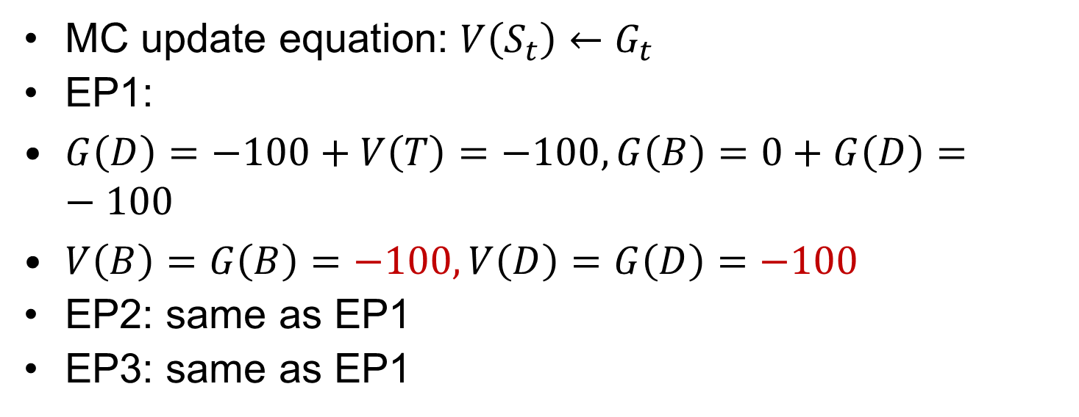


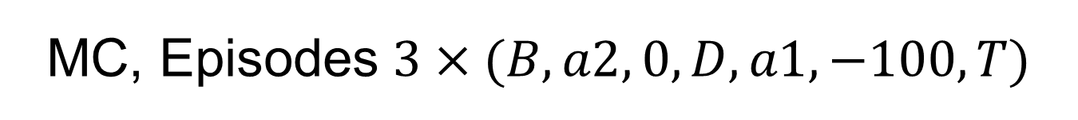



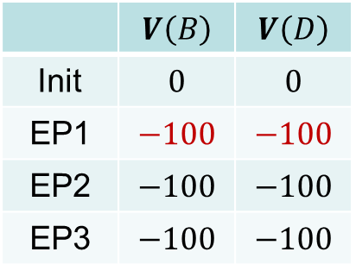

MC, Episodes $3×(B,a2, 0, D,a1,−100, T)$
MC update equation: $V\left(S_{t}\right)←G_{t}$
EP1:
$G\left(D\right)=−100+V\left(T\right)=−100,G\left(B\right)=0+G\left(D\right)=−100$
$V\left(B\right)=G\left(B\right)=−100, V\left(D\right)=G\left(D\right)=−100$
EP2: same as EP1
EP3: same as EP1
C
$$a1, r=1$$
 | $$V\left(B\right)$$ | $$V\left(D\right)$$
Init | $$0$$ | $$0$$
EP1 | $$−100$$ | $$−100$$
EP2 | $$−100$$ | $$−100$$
EP3 | $$−100$$ | $$−100$$
$$a1, r=1$$
B
$$a2, r=3$$
T
$$T$$
$a1, r=$-100
$$a2, r=0$$
D
$$a2, r=4$$

Slide 18

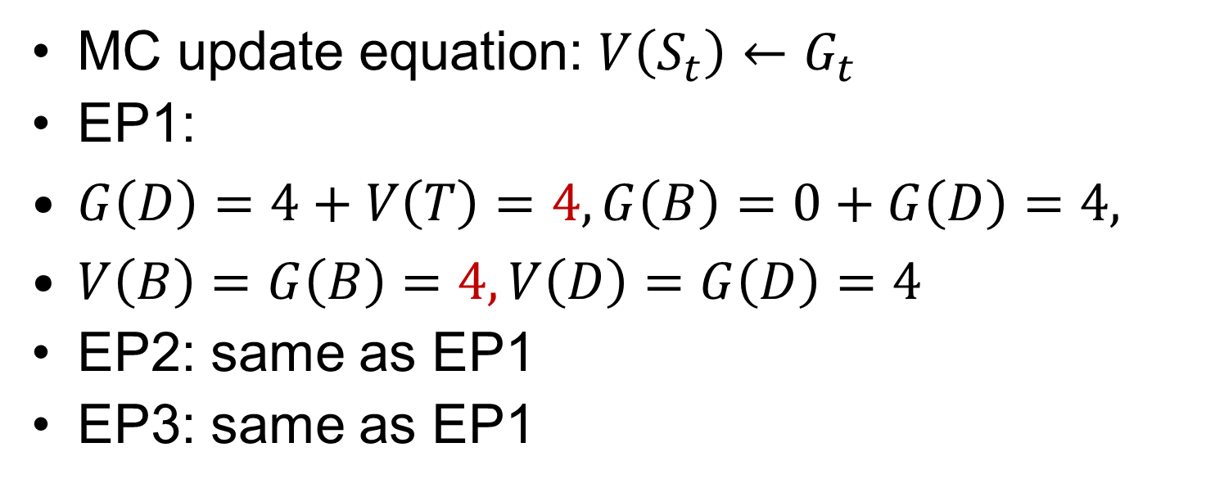

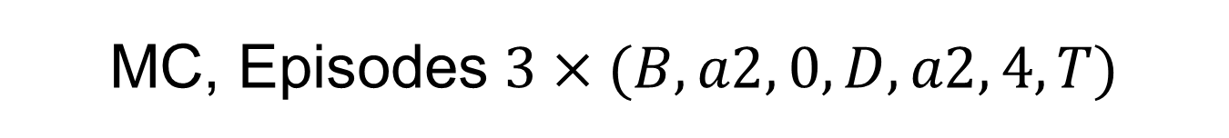



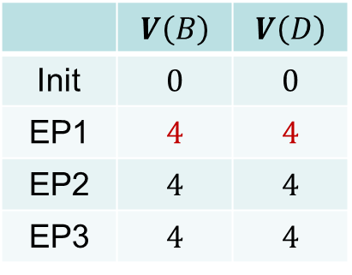

MC, Episodes $3×(B,a2, 0, D,a2, 4, T)$
MC update equation: $V\left(S_{t}\right)←G_{t}$
EP1:
$G\left(D\right)=4+V\left(T\right)=4,G\left(B\right)=0+G\left(D\right)=4,$
$V\left(B\right)=G\left(B\right)=4, V\left(D\right)=G\left(D\right)=4$
EP2: same as EP1
EP3: same as EP1
C
 | $$V\left(B\right)$$ | $$V\left(D\right)$$
Init | $$0$$ | $$0$$
EP1 | $$4$$ | $$4$$
EP2 | $$4$$ | $$4$$
EP3 | $$4$$ | $$4$$
$$a1, r=1$$
$$a1, r=1$$
B
$$a2, r=3$$
T
$a1, r=$-100
$$a2, r=0$$
D
$$a2, r=4$$

Slide 19
TD

Slide 20

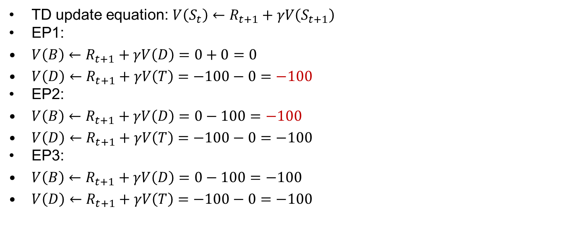

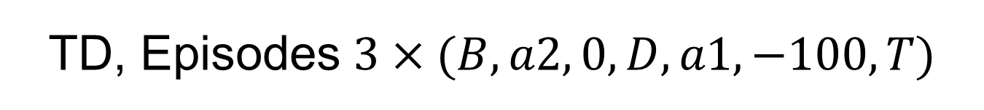



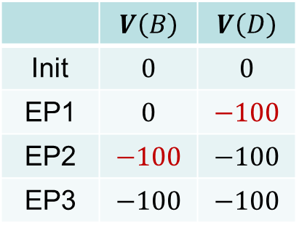

TD, Episodes $3×(B,a2, 0, D,a1,−100, T)$
TD update equation: $V\left(S_{t}\right)←R_{t+1}+γV\left(S_{t+1}\right)$
EP1:
$V\left(B\right)←R_{t+1}+γV\left(D\right)=0+0=0$
$V\left(D\right)←R_{t+1}+γV\left(T\right)=−100−0=−100$
EP2:
$V\left(B\right)←R_{t+1}+γV\left(D\right)=0−100=−100$
$V\left(D\right)←R_{t+1}+γV\left(T\right)=−100−0=−100$
EP3:
$V\left(B\right)←R_{t+1}+γV\left(D\right)=0−100=−100$
$V\left(D\right)←R_{t+1}+γV\left(T\right)=−100−0=−100$
C
 | $$V\left(B\right)$$ | $$V\left(D\right)$$
Init | $$0$$ | $$0$$
EP1 | $$0$$ | $$−100$$
EP2 | $$−100$$ | $$−100$$
EP3 | $$−100$$ | $$−100$$
$$a1, r=1$$
$$a1, r=1$$
B
$$a2, r=3$$
T
$a1, r=$-100
$$a2, r=0$$
D
$$a2, r=4$$

Slide 21

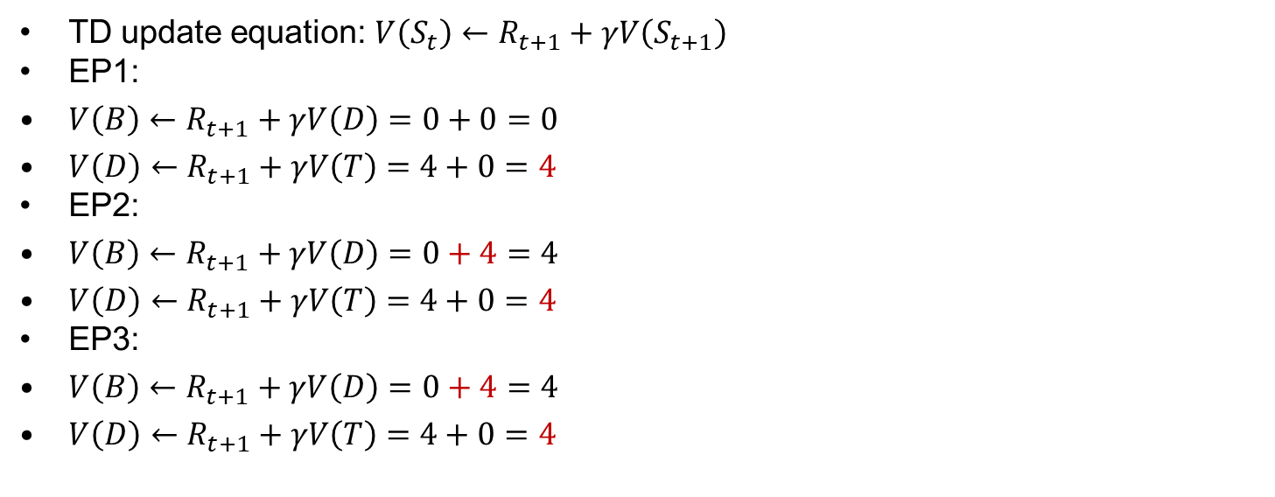


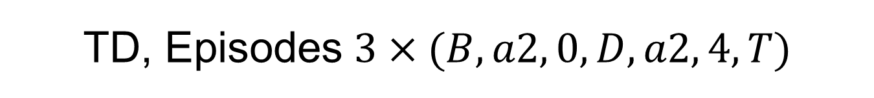



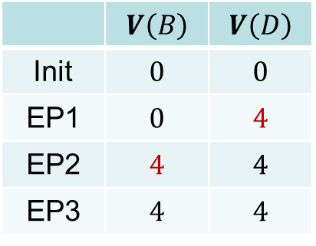

TD, Episodes $3×(B,a2, 0, D,a2, 4, T)$
TD update equation: $V\left(S_{t}\right)←R_{t+1}+γV\left(S_{t+1}\right)$
EP1:
$V\left(B\right)←R_{t+1}+γV\left(D\right)=0+0=0$
$V\left(D\right)←R_{t+1}+γV\left(T\right)=4+0=4$
EP2:
$V\left(B\right)←R_{t+1}+γV\left(D\right)=0+4=4$
$V\left(D\right)←R_{t+1}+γV\left(T\right)=4+0=4$
EP3:
$V\left(B\right)←R_{t+1}+γV\left(D\right)=0+4=4$
$V\left(D\right)←R_{t+1}+γV\left(T\right)=4+0=4$
C
 | $$V\left(B\right)$$ | $$V\left(D\right)$$
Init | $$0$$ | $$0$$
EP1 | $$0$$ | $$4$$
EP2 | $$4$$ | $$4$$
EP3 | $$4$$ | $$4$$
$$a1, r=1$$
$$a1, r=1$$
B
$$a2, r=3$$
T
$$T$$
$a1, r=$-100
$$a2, r=0$$
D
$$a2, r=4$$

Slide 22
Sarsa

Slide 23

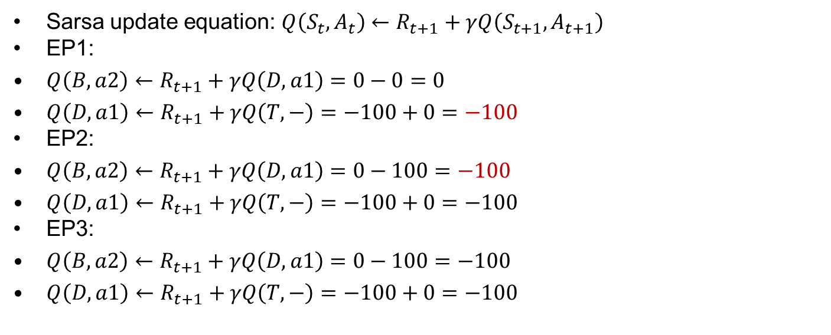

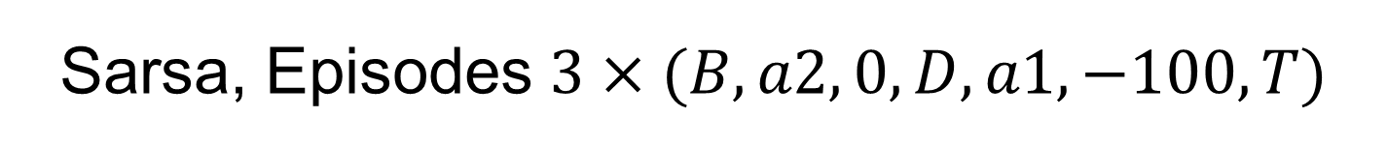



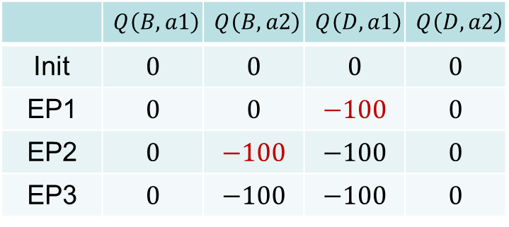

Sarsa, Episodes $3×(B,a2, 0,D,a1,−100, T)$
Sarsa update equation: $Q\left(S_{t},A_{t}\right)←R_{t+1}+γQ\left(S_{t+1},A_{t+1}\right)$
EP1:
$Q\left(B,a2\right)←R_{t+1}+γQ\left(D,a1\right)=0−0=0$
$Q\left(D,a1\right)←R_{t+1}+γQ\left(T,−\right)=−100+0=−100$
EP2:
$Q\left(B,a2\right)←R_{t+1}+γQ\left(D,a1\right)=0−100=−100$
$Q\left(D,a1\right)←R_{t+1}+γQ\left(T,−\right)=−100+0=−100$
EP3:
$Q\left(B,a2\right)←R_{t+1}+γQ\left(D,a1\right)=0−100=−100$
$Q\left(D,a1\right)←R_{t+1}+γQ\left(T,−\right)=−100+0=−100$
C
$$a1, r=1$$
 | $$Q\left(B, a1\right)$$ | $$Q\left(B,a2\right)$$ | $$Q\left(D, a1\right)$$ | $$Q\left(D, a2\right)$$
Init | $$0$$ | $$0$$ | $$0$$ | $$0$$
EP1 | $$0$$ | $$0$$ | $$−100$$ | $$0$$
EP2 | $$0$$ | $$−100$$ | $$−100$$ | $$0$$
EP3 | $$0$$ | $$−100$$ | $$−100$$ | $$0$$
$$a1, r=1$$
B
$$a2, r=3$$
T
$a1, r=$-100
$$a2, r=0$$
D
$$a2, r=4$$

Slide 24

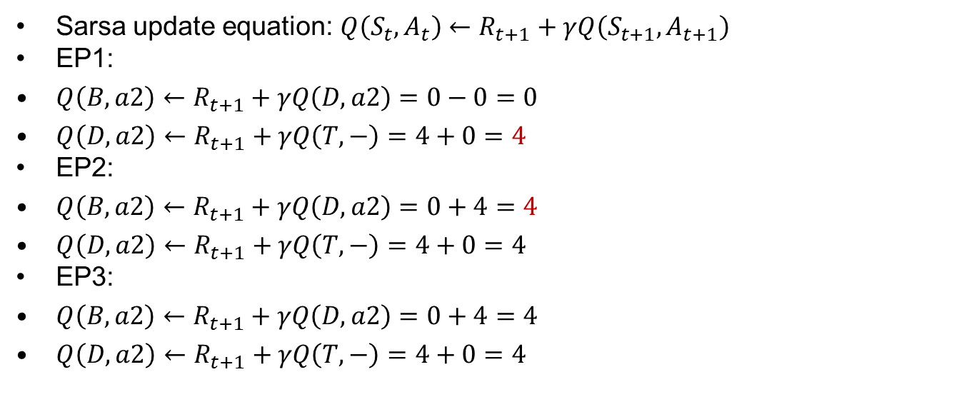

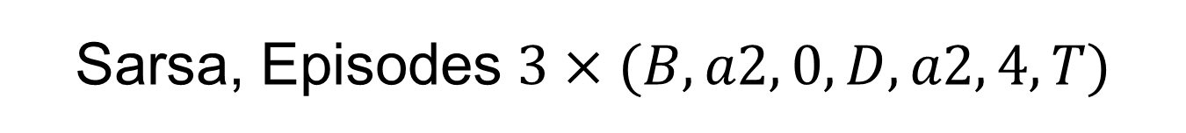



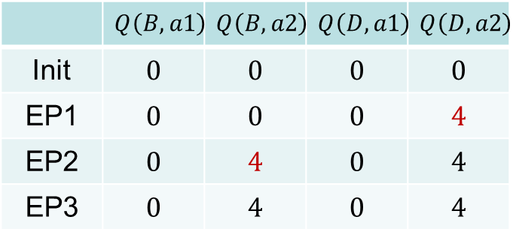

Sarsa, Episodes $3×(B,a2, 0,D,a2, 4, T)$
Sarsa update equation: $Q\left(S_{t},A_{t}\right)←R_{t+1}+γQ\left(S_{t+1},A_{t+1}\right)$
EP1:
$Q\left(B,a2\right)←R_{t+1}+γQ\left(D,a2\right)=0−0=0$
$Q\left(D,a2\right)←R_{t+1}+γQ\left(T,−\right)=4+0=4$
EP2:
$Q\left(B,a2\right)←R_{t+1}+γQ\left(D,a2\right)=0+4=4$
$Q\left(D,a2\right)←R_{t+1}+γQ\left(T,−\right)=4+0=4$
EP3:
$Q\left(B,a2\right)←R_{t+1}+γQ\left(D,a2\right)=0+4=4$
$Q\left(D,a2\right)←R_{t+1}+γQ\left(T,−\right)=4+0=4$
C
$$a1, r=1$$
$$a1, r=1$$
 | $$Q\left(B, a1\right)$$ | $$Q\left(B, a2\right)$$ | $$Q\left(D, a1\right)$$ | $$Q\left(D, a2\right)$$
Init | $$0$$ | $$0$$ | $$0$$ | $$0$$
EP1 | $$0$$ | $$0$$ | $$0$$ | $$4$$
EP2 | $$0$$ | $$4$$ | $$0$$ | $$4$$
EP3 | $$0$$ | $$4$$ | $$0$$ | $$4$$
B
$$a2, r=3$$
T
$a1, r=$-100
$$a2, r=0$$
D
$$a2, r=4$$

Slide 25

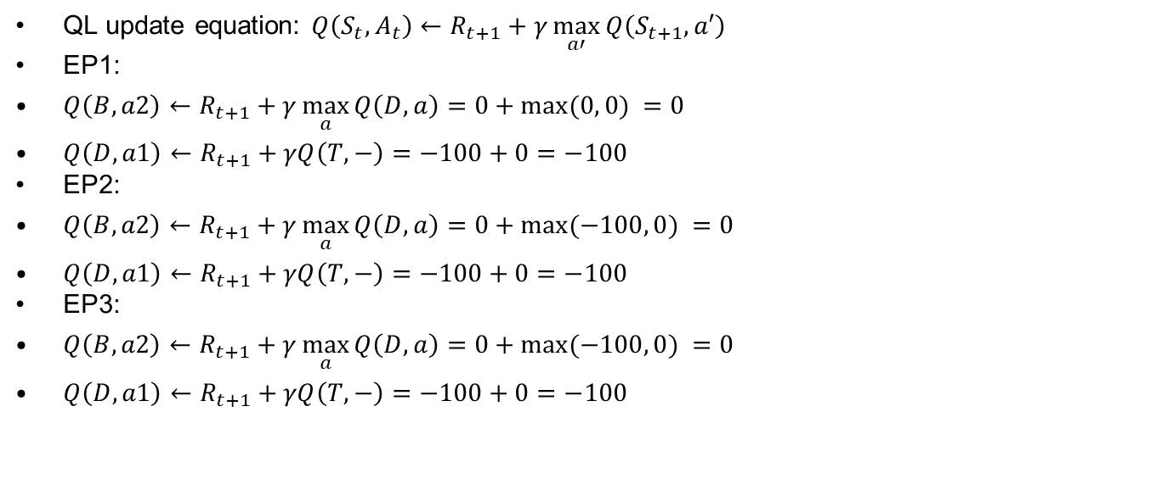


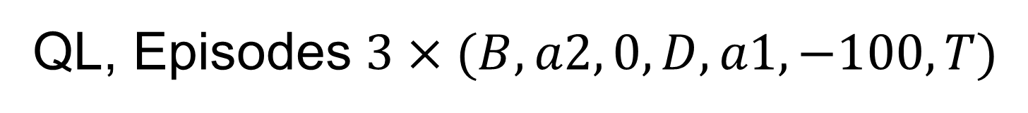



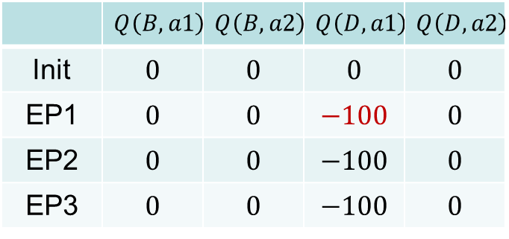

QL, Episodes $3×(B,a2, 0,D,a1,−100, T)$
QL update equation: $Q\left(S_{t},A_{t}\right)←R_{t+1}+γ\max_{a′}{Q\left(S_{t+1},a′\right)}$
EP1:
$Q\left(B,a2\right)←R_{t+1}+γ\max_{a}{Q\left(D,a\right)}=0+max⁡(0, 0) =0$
$Q\left(D,a1\right)←R_{t+1}+γQ\left(T,−\right)=−100+0=−100$
EP2:
$Q\left(B,a2\right)←R_{t+1}+γ\max_{a}{Q\left(D,a\right)}=0+max⁡(−100, 0) =0$
$Q\left(D,a1\right)←R_{t+1}+γQ\left(T,−\right)=−100+0=−100$
EP3:
$Q\left(B,a2\right)←R_{t+1}+γ\max_{a}{Q\left(D,a\right)}=0+max⁡(−100, 0) =0$
$Q\left(D,a1\right)←R_{t+1}+γQ\left(T,−\right)=−100+0=−100$
C
$$a1, r=1$$
 | $$Q\left(B, a1\right)$$ | $$Q\left(B, a2\right)$$ | $$Q\left(D, a1\right)$$ | $$Q\left(D, a2\right)$$
Init | $$0$$ | $$0$$ | $$0$$ | $$0$$
EP1 | $$0$$ | $$0$$ | $$−100$$ | $$0$$
EP2 | $$0$$ | $$0$$ | $$−100$$ | $$0$$
EP3 | $$0$$ | $$0$$ | $$−100$$ | $$0$$
$$a1, r=1$$
B
$$a2, r=3$$
T
$$T$$
$a1, r=$-100
$$a2, r=0$$
D
$$a2, r=4$$

Slide 26
Q Learning

Slide 27

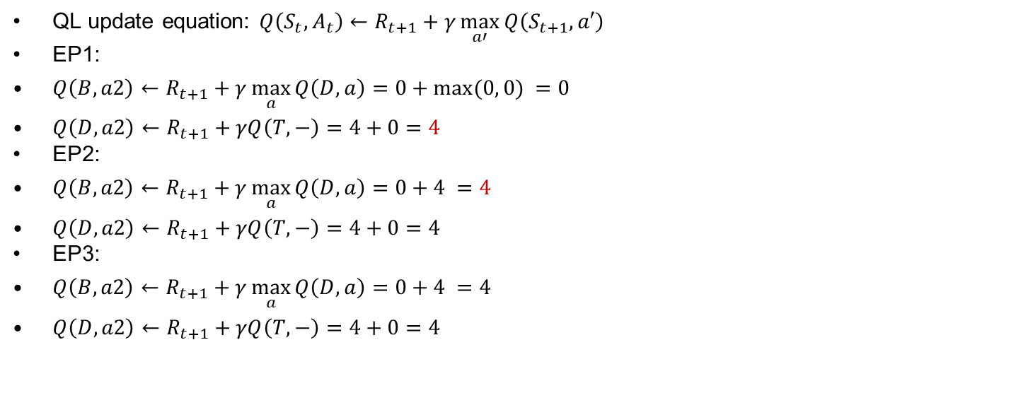





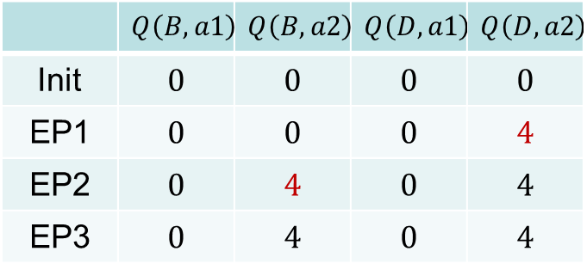

QL, Episodes $3×(B,2, 0,D,2, 4, T)$
QL update equation: $Q\left(S_{t},A_{t}\right)←R_{t+1}+γ\max_{a′}{Q\left(S_{t+1},a′\right)}$
EP1:
$Q\left(B,a2\right)←R_{t+1}+γ\max_{a}{Q\left(D,a\right)}=0+max⁡(0, 0) =0$
$Q\left(D,a2\right)←R_{t+1}+γQ\left(T,−\right)=4+0=4$
EP2:
$Q\left(B,a2\right)←R_{t+1}+γ\max_{a}{Q\left(D,a\right)}=0+4 =4$
$Q\left(D,a2\right)←R_{t+1}+γQ\left(T,−\right)=4+0=4$
EP3:
$Q\left(B,a2\right)←R_{t+1}+γ\max_{a}{Q\left(D,a\right)}=0+4 =4$
$Q\left(D,a2\right)←R_{t+1}+γQ\left(T,−\right)=4+0=4$
C
$$a1, r=1$$
 | $$Q\left(B, a1\right)$$ | $$Q\left(B, a2\right)$$ | $$Q\left(D, a1\right)$$ | $$Q\left(D, a2\right)$$
Init | $$0$$ | $$0$$ | $$0$$ | $$0$$
EP1 | $$0$$ | $$0$$ | $$0$$ | $$4$$
EP2 | $$0$$ | $$4$$ | $$0$$ | $$4$$
EP3 | $$0$$ | $$4$$ | $$0$$ | $$4$$
$$a1, r=1$$
B
$$a2, r=3$$
T
$a1, r=$-100
$$a2, r=0$$
D
$$a2, r=4$$

Slide 28
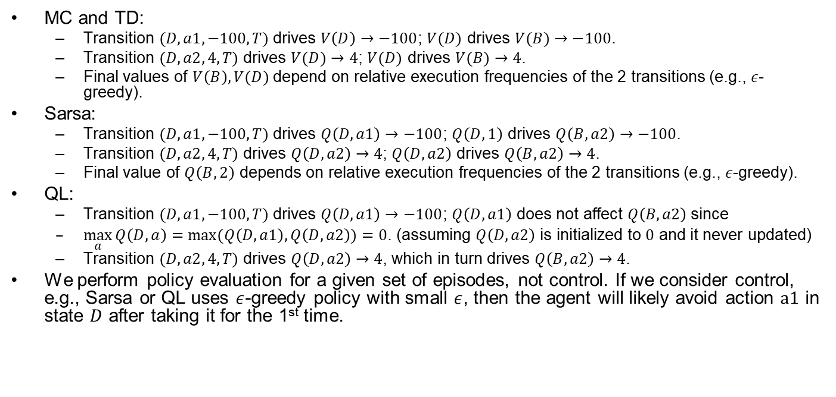
Comparisons
MC and TD:
Transition $(D,a1,−100,T)$ drives $V\left(D\right)→−100$; $V(D)$ drives $V(B)→−100$.
Transition $(D,a2, 4,T)$ drives $V(D)→4$; $V(D)$ drives $V(B)→4$.
Final values of $V\left(B\right),V(D)$ depend on relative execution frequencies of the 2 transitions (e.g., $ε$-greedy).
Sarsa:
Transition $(D,a1,−100,T)$ drives $Q\left(D,a1\right)→−100$; $Q\left(D,1\right)$ drives $Q\left(B,a2\right)→−100$.
Transition $(D,a2, 4,T)$ drives $Q\left(D,a2\right)→4$; $Q\left(D,a2\right)$ drives $Q\left(B,a2\right)→4$.
Final value of $Q\left(B,2\right)$ depends on relative execution frequencies of the 2 transitions (e.g., $ε$-greedy).
QL:
Transition $(D,a1,−100,T)$ drives $Q\left(D,a1\right)→−100$; $Q\left(D,a1\right)$ does not affect $Q\left(B,a2\right)$ since
$\max_{a}{Q\left(D,a\right)}=\max{(Q\left(D,a1\right),Q\left(D,a2\right))}=0$. (assuming $Q\left(D,a2\right)$ is initialized to $0$ and it never updated)
Transition $(D,a2, 4,T)$ drives $Q\left(D,a2\right)→4$, which in turn drives $Q\left(B,a2\right)→4$.
We perform policy evaluation for a given set of episodes, not control. If we consider control, e.g., Sarsa or QL uses $ε$-greedy policy with small $ε$, then the agent will likely avoid action $a1$ in state $D$ after taking it for the 1st time.
C
$$a1, r=1$$
$$a1, r=1$$
B
$$a2, r=3$$
T
$a1, r=$-100
$$a2, r=0$$
D
$$a2, r=4$$
Notes:
(Here we assume the upper transition $(B,a=1, 1,C)$ is never taken, otherwise we need to account for more cases.)
Depends on relative execution frequencies of
$$Q\left(B,2\right)→4,Q\left(D,2\right)→4$$

Slide 29
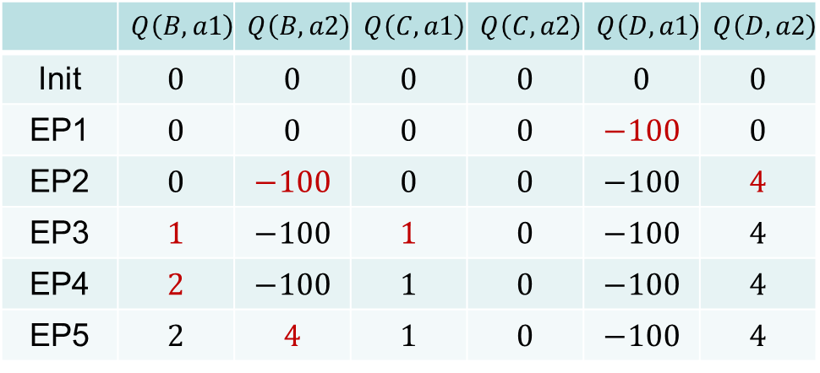





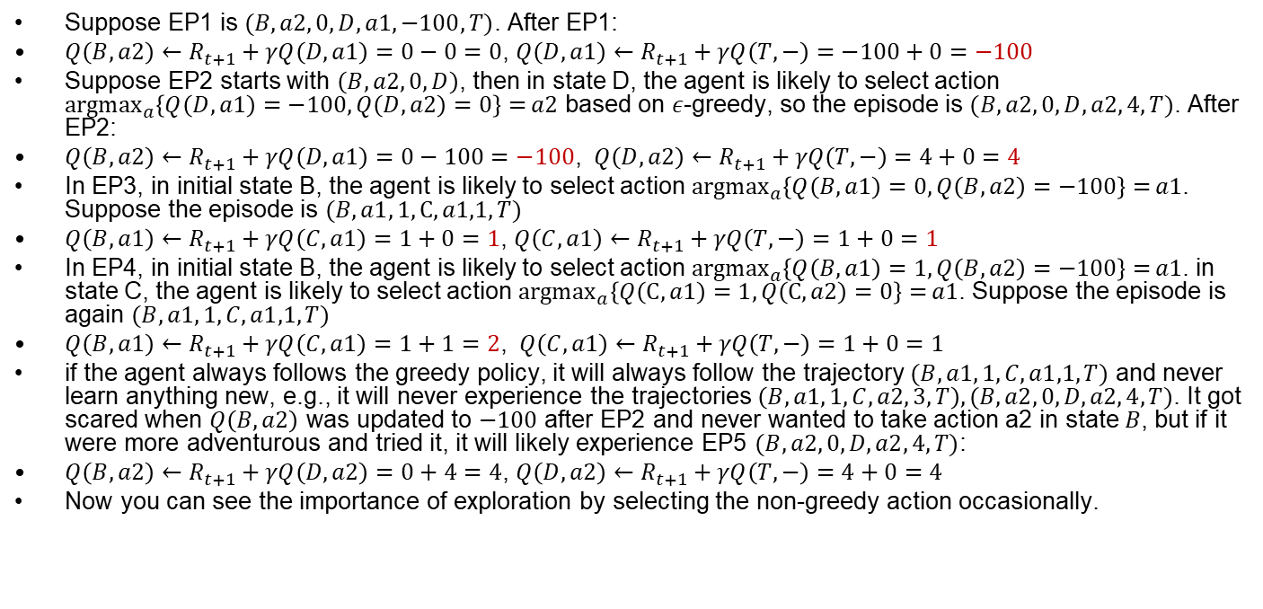


Sarsa w. $ε$-greedy
Suppose EP1 is $(B,a2, 0,D,a1,−100, T)$. After EP1:
$Q\left(B,a2\right)←R_{t+1}+γQ\left(D,a1\right)=0−0=0$, $Q\left(D,a1\right)←R_{t+1}+γQ\left(T,−\right)=−100+0=−100$
Suppose EP2 starts with $\left(B,a2, 0,D\right)$, then in state D, the agent is likely to select action ${argmax}_{a}\left\{Q\left(D,a1\right)=−100,Q\left(D,a2\right)=0\right\}={a2}$ based on $ε$-greedy, so the episode is $(B,a2, 0,D,a2, 4, T)$. After EP2:
$Q\left(B,a2\right)←R_{t+1}+γQ\left(D,a1\right)=0−100=−100$, $Q\left(D,a2\right)←R_{t+1}+γQ\left(T,−\right)=4+0=4$
In EP3, in initial state B, the agent is likely to select action ${argmax}_{a}\left\{Q\left(B,a1\right)=0,Q\left(B,a2\right)=−100\right\}={a1}$. Suppose the episode is $(B,a1, 1,C,a1,1, T)$
$Q\left(B,a1\right)←R_{t+1}+γQ\left(C,a1\right)=1+0=1$, $Q\left(C,a1\right)←R_{t+1}+γQ\left(T,−\right)=1+0=1$
In EP4, in initial state B, the agent is likely to select action ${argmax}_{a}\left\{Q\left(B,a1\right)=1,Q\left(B,a2\right)=−100\right\}={a1}$. in state C, the agent is likely to select action ${argmax}_{a}\left\{Q\left(C,a1\right)=1,Q\left(C,a2\right)=0\right\}={a1}$. Suppose the episode is again $(B,a1, 1,C,a1,1, T)$
$Q\left(B,a1\right)←R_{t+1}+γQ\left(C,a1\right)=1+1=2$, $Q\left(C,a1\right)←R_{t+1}+γQ\left(T,−\right)=1+0=1$
if the agent always follows the greedy policy, it will always follow the trajectory $(B,a1, 1,C,a1,1, T)$ and never learn anything new, e.g., it will never experience the trajectories $\left(B,a1, 1,C,a2, 3, T\right),(B,a2, 0,D,a2, 4, T)$. It got scared when $Q\left(B,a2\right)$ was updated to $−100$ after EP2 and never wanted to take action a2 in state $B$, but if it were more adventurous and tried it, it will likely experience EP5 $(B,a2, 0,D,a2, 4, T)$:
$Q\left(B,a2\right)←R_{t+1}+γQ\left(D,a2\right)=0+4=4$, $Q\left(D,a2\right)←R_{t+1}+γQ\left(T,−\right)=4+0=4$
Now you can see the importance of exploration by selecting the non-greedy action occasionally.
 | $$Q\left(B, a1\right)$$ | $$Q\left(B, a2\right)$$ | $$Q\left(C, a1\right)$$ | $$Q\left(C, a2\right)$$ | $$Q\left(D, a1\right)$$ | $$Q\left(D, a2\right)$$
Init | $$0$$ | $$0$$ | $$0$$ | $$0$$ | $$0$$ | $$0$$
EP1 | $$0$$ | $$0$$ | $$0$$ | $$0$$ | $$−100$$ | $$0$$
EP2 | $$0$$ | $$−100$$ | $$0$$ | $$0$$ | $$−100$$ | $$4$$
EP3 | $$1$$ | $$−100$$ | $$1$$ | $$0$$ | $$−100$$ | $$4$$
$$\text{EP}\text{4}$$ | $$2$$ | $$−100$$ | $$1$$ | $$0$$ | $$−100$$ | $$4$$
EP5 | $$2$$ | $$4$$ | $$1$$ | $$0$$ | $$−100$$ | $$4$$
C
$$a1, r=1$$
$$a1, r=1$$
B
$$a2, r=3$$
T
$a1, r=$-100
$$T$$
$$a2, r=0$$
D
$$a2, r=4$$
Notes:
Sarsa update equation: $Q\left(S_{t},A_{t}\right)←R_{t+1}+γQ\left(S_{t+1},A_{t+1}\right)$

Slide 30
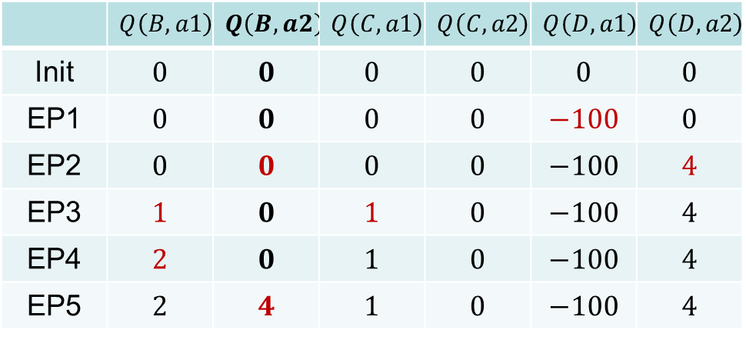





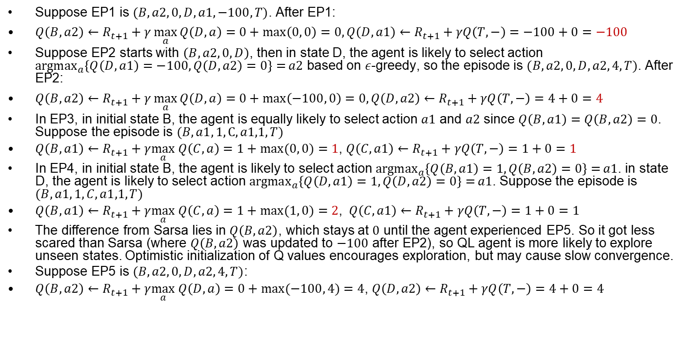


QL w. $ε$-greedy
Suppose EP1 is $(B,a2, 0,D,a1,−100, T)$. After EP1:
$Q\left(B,a2\right)←R_{t+1}+γ\max_{a}{Q\left(D,a\right)}=0+\max\left(0, 0\right)=0, Q\left(D,a1\right)←R_{t+1}+γQ\left(T,−\right)=−100+0=−100$
Suppose EP2 starts with $\left(B,a2, 0,D\right)$, then in state D, the agent is likely to select action ${argmax}_{a}\left\{Q\left(D,a1\right)=−100,Q\left(D,a2\right)=0\right\}={a2}$ based on $ε$-greedy, so the episode is $(B,a2, 0,D,a2, 4, T)$. After EP2:
$Q\left(B,a2\right)←R_{t+1}+γ\max_{a}{Q\left(D,a\right)}=0+\max\left(−100, 0\right)=0, Q\left(D,a2\right)←R_{t+1}+γQ\left(T,−\right)=4+0=4$
In EP3, in initial state B, the agent is equally likely to select action $a1$ and $a2$ since $Q\left(B,a1\right)=Q\left(B,a2\right)=0$. Suppose the episode is $(B,a1, 1,C,a1,1, T)$
$Q\left(B,a1\right)←R_{t+1}+γ\max_{a} Q\left(C,a\right)=1+max⁡(0, 0)=1$, $Q\left(C,a1\right)←R_{t+1}+γQ\left(T,−\right)=1+0=1$
In EP4, in initial state B, the agent is likely to select action ${argmax}_{a}\left\{Q\left(B,a1\right)=1,Q\left(B,a2\right)=0\right\}={a1}$. in state D, the agent is likely to select action ${argmax}_{a}\left\{Q\left(D,a1\right)=1,Q\left(D,a2\right)=0\right\}={a1}$. Suppose the episode is $(B,a1, 1,C,a1,1, T)$
$Q\left(B,a1\right)←R_{t+1}+γ\max_{a} Q\left(C,a\right)=1+max⁡(1, 0)=2$, $Q\left(C,a1\right)←R_{t+1}+γQ\left(T,−\right)=1+0=1$
The difference from Sarsa lies in $Q\left(B,a2\right)$, which stays at $0$ until the agent experienced EP5. So it got less scared than Sarsa (where $Q\left(B,a2\right)$ was updated to $−100$ after EP2), so QL agent is more likely to explore unseen states. Optimistic initialization of Q values encourages exploration, but may cause slow convergence.
Suppose EP5 is $(B,a2, 0,D,a2, 4, T)$:
$Q\left(B,a2\right)←R_{t+1}+γ\max_{a} Q\left(D,a\right)=0+\max{(−100, 4)}=4$, $Q\left(D,a2\right)←R_{t+1}+γQ\left(T,−\right)=4+0=4$
 | $$Q\left(B, a1\right)$$ | $$Q\left(B, a2\right)$$ | $$Q\left(C, a1\right)$$ | $$Q\left(C, a2\right)$$ | $$Q\left(D, a1\right)$$ | $$Q\left(D, a2\right)$$
Init | $$0$$ | $$0$$ | $$0$$ | $$0$$ | $$0$$ | $$0$$
EP1 | $$0$$ | $$0$$ | $$0$$ | $$0$$ | $$−100$$ | $$0$$
EP2 | $$0$$ | $$0$$ | $$0$$ | $$0$$ | $$−100$$ | $$4$$
EP3 | $$1$$ | $$0$$ | $$1$$ | $$0$$ | $$−100$$ | $$4$$
$$\text{EP}\text{4}$$ | $$2$$ | $$0$$ | $$1$$ | $$0$$ | $$−100$$ | $$4$$
EP5 | $$2$$ | $$4$$ | $$1$$ | $$0$$ | $$−100$$ | $$4$$
C
$$a1, r=1$$
$$a1, r=1$$
B
$$a2, r=3$$
T
$a1, r=$-100
$$T$$
$$a2, r=0$$
D
$$a2, r=4$$
Notes:
QL update equation: $Q\left(S_{t},A_{t}\right)←R_{t+1}+γ\max_{a′}{Q\left(S_{t+1},a′\right)}$

Slide 31
Linear Chain Example

Slide 32
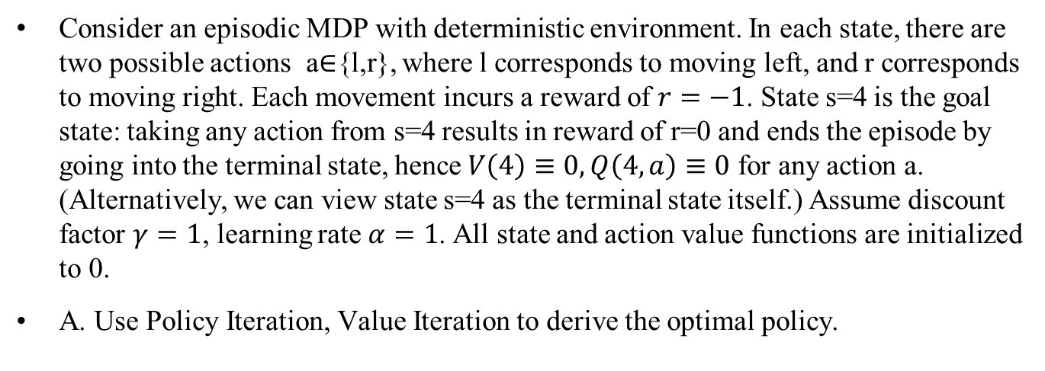
Linear Chain Example
Consider an episodic MDP with deterministic environment. In each state, there are two possible actions a∈{l,r}, where l corresponds to moving left, and r corresponds to moving right. Each movement incurs a reward of $r=−1$. State s=4 is the goal state: taking any action from s=4 results in reward of r=0 and ends the episode by going into the terminal state, hence $V\left(4\right)≡0,Q\left(4,a\right)≡0$ for any action a. (Alternatively, we can view state s=4 as the terminal state itself.) Assume discount factor $γ=1$, learning rate $α=1$. All state and action value functions are initialized to 0.
A. Use Policy Iteration, Value Iteration to derive the optimal policy.

Slide 33
Policy Iteration

Slide 34
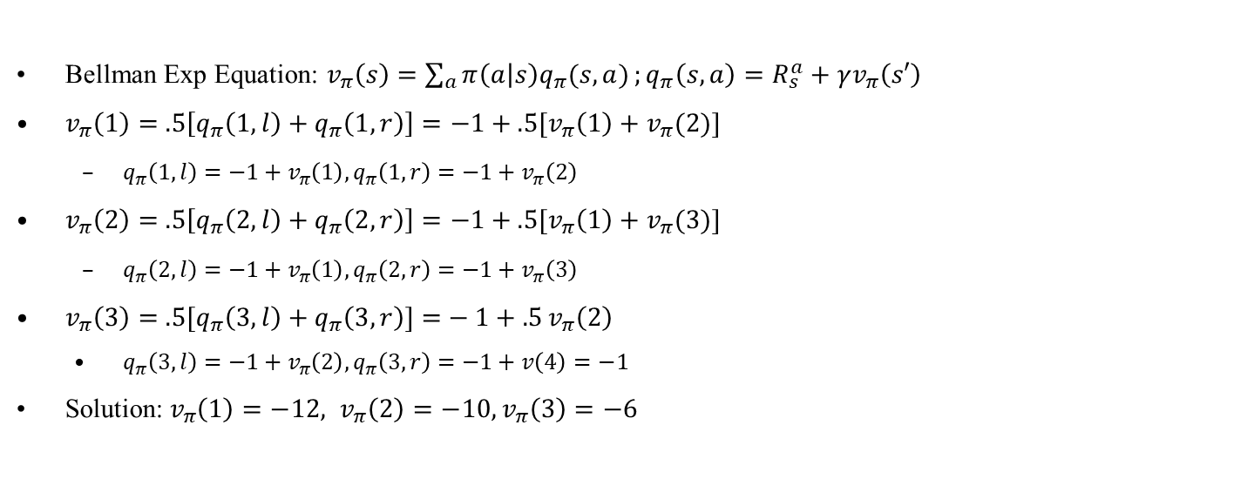

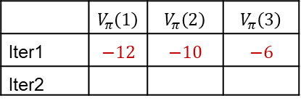
1.1 Policy Evaluation of Random Policy
BF=2
BF=1
Bellman Exp Equation: $v_{π}\left(s\right)=\sum_{a}{π\left(a | s\right)q_{π}(s,a)};q_{π}\left(s,a\right)=R_{s}^{a}+γv_{π}\left(s′\right)$
$v_{π}\left(1\right)=$ $.5\left[q_{π}\left(1,l\right)+q_{π}\left(1,r\right)\right]=−1+.5[v_{π}\left(1\right)+v_{π}(2)]$
$q_{π}\left(1,l\right)=−1+v_{π}\left(1\right),q_{π}\left(1,r\right)=−1+v_{π}\left(2\right)$
$v_{π}\left(2\right)=$ $.5\left[q_{π}\left(2,l\right)+q_{π}\left(2,r\right)\right]=−1+.5[v_{π}\left(1\right)+v_{π}(3)]$
$q_{π}\left(2,l\right)=−1+v_{π}\left(1\right),q_{π}\left(2,r\right)=−1+v_{π}\left(3\right)$
$v_{π}\left(3\right)=$ $.5[q_{π}\left(3,l\right)+q_{π}\left(3,r\right)]{=}−1+.5{v_{π}\left(2\right)}$
$q_{π}\left(3,l\right)=−1+v_{π}\left(2\right),q_{π}\left(3,r\right)=−1+v\left(4\right)=−1$
Solution:$v_{π}\left(1\right)=−12, v_{π}\left(2\right)=−10, v_{π}\left(3\right)=−6$
 | $$V_{π}\left(1\right)$$ | $$V_{π}\left(2\right)$$ | $$V_{π}\left(3\right)$$
Iter1 | $$−12$$ | $$−10$$ | $$−6$$
Iter2
-12
-10
-6
(Column $V_{∗}\left(4\right)$ is omitted
since it is always 0)

Slide 35

1.2 Policy Improvement
Plug in values from PE to get new policy
$π^{′}\left(1\right)={argmax}_{a}\left(q_{π}\left(1,l\right),q_{π}\left(1,r\right)\right)=r$
$q_{π}\left(1,l\right)=−1+v_{π}\left(1\right)=−13, q_{π}\left(1,r\right)=−1+v_{π}\left(2\right)=−11,$
$π^{′}\left(2\right)={argmax}_{a}\left(q_{π}\left(2,l\right),q_{π}\left(2,r\right)\right)=r$
$q_{π}\left(2,l\right)=−1+v_{π}\left(1\right)=−13,q_{π}\left(2,r\right)=−1+v_{π}\left(3\right)=−7$
$π^{′}\left(3\right)={argmax}_{a}\left(q_{π}\left(3,l\right),q_{π}\left(3,r\right)\right)=r$
$q_{π}\left(3,l\right)=−1+v_{π}\left(2\right)=−11,q_{π}\left(3,r\right)=−1$
-12
-10
-6

Slide 36


2.1 Policy Evaluation of Det Policy
BF=1
BF=1
$v_{π}\left(1\right)=$ $1.0q_{π}\left(1,r\right)=−1+v_{π}\left(2\right)$
$q_{π}\left(1,r\right)=−1+v_{π}\left(2\right)$
$v_{π}\left(2\right)=$ $1.0q_{π}\left(2,r\right)=−1+v_{π}\left(3\right)$
$q_{π}\left(2,r\right)=−1+v_{π}\left(3\right)$
$v_{π}\left(3\right)=$ $1.0q_{π}\left(3,r\right)=−1$
$q_{π}\left(3,r\right)=−1$
Solution:$v_{π}\left(1\right)=−3, v_{π}\left(2\right)=−2, v_{π}\left(3\right)=−1$
 | $$V_{π}\left(1\right)$$ | $$V_{π}\left(2\right)$$ | $$V_{π}\left(3\right)$$
Iter1 | $$−12$$ | $$−10$$ | $$−6$$
Iter2 | $$−3$$ | $$−2$$ | $$−1$$
-3
-2
-1

Slide 37

2.2 Policy Improvement
Plug in values from PE to get new policy
$π^{′}\left(1\right)={argmax}_{a}\left(q_{π}\left(1,l\right),q_{π}\left(1,r\right)\right)=r$
$q_{π}\left(1,l\right)=−1−3=−4,q_{π}\left(1,r\right)=−1−2=−3$
$π^{′}\left(2\right)={argmax}_{a}\left(q_{π}\left(2,l\right),q_{π}\left(2,r\right)\right)=r$
$q_{π}\left(2,l\right)=−1−3=−4,q_{π}\left(2,r\right)=−1−1=−2$
$π^{′}\left(3\right)={argmax}_{a}\left(q_{π}\left(3,l\right),q_{π}\left(3,r\right)\right)=r$
$q_{π}\left(3,l\right)=−1−2=−3,q_{π}\left(3,r\right)=−1$
Policy is now stable ($π^{′}=π$), so we have found the optimal policy
-3
-2
-1

Slide 38
Value Iteration

Slide 39



Value Iteration
BF=2
Bellman Opt Equation: $v_{∗}\left(s\right)=\max_{a} q_{∗}\left(s,a\right);q_{∗}\left(s,a\right)=R_{s}^{a}+γv_{∗}\left(s′\right)$
$v_{∗}\left(1\right)=\max_{a}\left[q_{∗}\left(1,l\right),q_{∗}\left(1,r\right)\right]=\max_{a}\left[−1+v_{∗}\left(1\right),−1+v_{∗}\left(2\right)\right]$
$q_{∗}\left(1,l\right)=−1+v_{∗}\left(1\right),q_{∗}\left(1,r\right)=−1+v_{∗}\left(2\right)$
$v_{∗}\left(2\right)=\max_{a}\left[q_{∗}\left(2,l\right),q_{∗}\left(2,r\right)\right]=\max_{a}\left[−1+v_{∗}\left(1\right),−1+v_{∗}\left(3\right)\right]$
$q_{∗}\left(2,l\right)=−1+v_{∗}\left(1\right),q_{∗}\left(2,r\right)=−1+v_{∗}\left(3\right)$
$v_{∗}\left(3\right)=\max_{a}\left[q_{∗}\left(3,l\right),q_{∗}\left(3,r\right)\right]=\max_{a}\left[−1+v_{∗}\left(2\right),−1+v\left(4\right)\right]=\max_{a}\left[−1+v_{∗}\left(2\right),−1\right]$
$q_{∗}\left(3,l\right)=−1+v_{∗}\left(2\right),q_{∗}\left(3,r\right)=−1+v\left(4\right)=−1$
We use Value Iteration to solve it. Table shows the iteration process until convergence (not using in-place updates for clarity). Solution:$v_{∗}\left(1\right)=−3, v_{∗}\left(2\right)=−2, v_{∗}\left(3\right)=−1$
Optimal policy: $π_{∗}\left(1\right)=\underset{a}{argmax}{q_{∗}\left(1,a\right)}=r;π_{∗}\left(2\right)=\underset{a}{argmax}{q_{∗}\left(2,a\right)}=r;π_{∗}\left(3\right)=\underset{a}{argmax}{q_{∗}\left(3,a\right)}=r$
BF=1
(Column $V_{∗}\left(4\right)≡0$ is omitted)
 | $$V_{∗}\left(1\right)$$ | $$V_{∗}\left(2\right)$$ | $$V_{∗}\left(3\right)$$
Init | $$0$$ | $$0$$ | $$0$$
Iter1 | $$−1$$ | $$−1$$ | $$−1$$
Iter2 | $$−2$$ | $$−2$$ | $$−1$$
Iter3 | $$−3$$ | $$−2$$ | $$−1$$
Iter4 | $$−3$$ | $$−2$$ | $$−1$$
-3
-2
-1
Notes:
Bellman Opt Equation: $v_{∗}\left(s\right)=$ $\max_{a}{\sum_{r,s^{′}}{p\left(r,s′ | s,a\right)}\left[r+γv_{∗}\left(s^{′}\right)\right]}$
(There is no analytical method for solving nonlinear equations with $\max_{a}$ operator, and you need to . In this case the solution is easy to see by observation, but in general you need to use iterative solving method.)

Slide 40

MC, TD, Sarsa, QL (Simple)
B. Assume learning rate $α=0.5$. Consider an episode in the form of (s,a,r) :
EP1: $(3, l, −1),(2, r, −1),(3, r, −1),(4, r, 0)$
Derive the following:
State value functions $V(s)$ after MC learning.
State value functions $V(s)$ after TD learning.
State-action value functions $Q(s, a)$ after Sarsa, and the resulting policy.
State-action value functions $Q(s, a)$ after Q learning, and the resulting policy.

Slide 41


MC EP1
MC update equation:$V\left(S_{t}\right)←V\left(S_{t}\right)+α(G(S_{t})−V(S_{t}))$
$V\left(4\right)≡0.$ Initialize $V\left(1\right)=V\left(2\right)=V\left(3\right)=0$
EP1: $(3, l, −1),(2, r, −1),(3, r, −1),(4, r, 0)$
MC (every-visit w. EP1 $3′→2→3→4$):
Update $G\left(s\right)$ backward:
$G\left(3\right)←−1$
$G\left(2\right)←−1+γG\left(3\right)=−1−1=−2$
$G\left(3′\right)←−1+γG\left(2\right)=−1−2=−3,$
Update $V\left(s\right)$ forward:
$V\left(3\right)←V\left(3\right)+α\left(G\left(3^{′}\right)−V\left(3\right)\right)=0+.5\left(−3−0\right)=−1.5$
$V\left(2\right)←V\left(2\right)+α\left(G\left(2\right)−V\left(2\right)\right)=0+.5\left(−2−0\right)=−1$
$V\left(3\right)←V\left(3\right)+α\left(G\left(3\right)−V\left(3\right)\right)=−1.5+.5\left(−1+1.5\right)=−1.25$
$G\left(3′\right)=−3$ is misleading: based on EP1 $3′→2→3→4$, the agent needs 3 steps to get to the terminal state by moving left in the 1st visit to state $3$, but in fact it only needs 1 step by moving right in the 2nd visit to state $3$. That is why “more recent visits are given more weight”. In the extreme case, if learning rate $α=1$, then each $V(S)$ is completely overwritten in each update, and we have a more correct estimate of $V\left(3\right)$:
$V\left(3\right)←V\left(3\right)+α\left(G\left(3^{′}\right)−V\left(3\right)\right)=0+1\left(−3−0\right)=−3$
$V\left(2\right)←V\left(2\right)+α\left(G\left(2\right)−V\left(2\right)\right)=0+1\left(−2−0\right)=−2$
$V\left(3\right)←V\left(3\right)+α\left(G\left(3\right)−V\left(3\right)\right)=−3+1\left(−1+3\right)=−1$
TD | $$V\left(1\right)$$ | $$V\left(2\right)$$ | $$V\left(3\right)$$
Init | $$0$$ | $$0$$ | $$0$$
After EP1 | $$−1.25$$ | $$−1$$ | $$−1.5$$
Notes:
$$V\left(S_{t}\right)←V\left(S_{t}\right)+α\left(G_{t}−V\left(S_{t}\right)\right)=G_{t}$$

Slide 42


TD EP1
TD update equation: $V\left(S_{t}\right)←V\left(S_{t}\right)+α(R_{t+1}+γV\left(S_{t+1}\right)−V(S_{t}))$
$V\left(4\right)≡0.$ Initialize $V\left(1\right)=V\left(2\right)=V\left(3\right)=0,$
EP1: $(3, l, −1),(2, r, −1),(3, r, −1),(4, r, 0)$
$V\left(3\right)←V\left(3\right)+α\left(R+γV\left(2\right)−V\left(3\right)\right)=0+.5\left(−1+0−0\right)=−0.5$
$V\left(2\right)←V\left(2\right)+α\left(R+γV\left(3\right)−V\left(2\right)\right)=0+.5\left(−1−.5−0\right)=−0.725$
$V\left(3\right)←V\left(3\right)+α\left(R+γV\left(4\right)−V\left(3\right)\right)=−.5+.5\left(−1+0+.5\right)=−0.75$
Arrows denote bootstrap dependencies, e.g., $V(3)$ bootstraps off $V(2)$, $V(2)$ bootstraps off $V(3)$, $V(3)$ bootstraps off $V(4)$. They also denote direction of information flow during learning, e.g.,$V\left(4\right)≡0$ is the external learning signal, and info flows $V\left(4\right)→V\left(3\right)$.
TD | $$V\left(1\right)$$ | $$V\left(2\right)$$ | $$V\left(3\right)$$
Init | $$0$$ | $$0$$ | $$0$$
After EP1 | $$0$$ | $$−725$$ | $$−0.5$$ $$−0.75$$

Slide 43


Sarsa EP1
Sarsa update equation: $Q\left(S_{t},A_{t}\right)←Q\left(S_{t},A_{t}\right)+α(R_{t+1}+γQ\left(S_{t+1},A_{t+1}\right)−Q\left(S_{t},A_{t}\right))$
$Q\left(4,a\right)≡0.$ Initialize $Q\left(1,∗\right)=Q\left(2,∗\right)=Q\left(3,∗\right)=0$
EP1: $(3, l, −1),(2, r, −1),(3, r, −1),(4, r, 0)$
$Q\left(3,l\right)←Q\left(3,l\right)+α\left(R+γQ\left(2,r\right)−Q\left(3,l\right)\right)=0+.5\left(−1+0−0\right)=−0.5$
$Q\left(2,r\right)←Q\left(2,r\right)+α\left(R+γQ\left(3,r\right)−Q\left(2,r\right)\right)=0+.5\left(−1+0−0\right)=−0.5$
$Q\left(3,r\right)←Q\left(3,r\right)+α\left(R+γQ\left(4,r\right)−Q\left(3,r\right)\right)=0+.5\left(−1+0−0\right)=−0.5$
Sarsa | $$Q\left(1,l\right)$$ | $$Q\left(1,r\right)$$ | $$Q\left(2,l\right)$$ | $$Q\left(2,r\right)$$ | $$Q\left(3,l\right)$$ | $$Q\left(3,r\right)$$
Init | $$0$$ | $$0$$ | $$0$$ | $$0$$ | $$0$$ | $$0$$
After EP1 | $$0$$ | $$0$$ | $$0$$ | $$−0.5$$ | $$−0.5$$ | $$−0.5$$
(Column $Q\left(4, r\right)$ is omitted since it is always 0)

Slide 44

QL EP1
QL update equation: $Q\left(S_{t},A_{t}\right)←Q\left(S_{t},A_{t}\right)+α(R_{t+1}+γ\max_{a′}{Q\left(S_{t+1},a′\right)}−Q\left(S_{t},A_{t}\right))$
$Q\left(4,a\right)≡0.$ Initialize $Q\left(1,∗\right)=Q\left(2,∗\right)=Q\left(3,∗\right)=0$
EP1: $(3, l, −1),(2, r, −1),(3, r, −1),(4, r, 0)$
$Q\left(3,l\right)←Q\left(3,l\right)+α\left(R+γ\max_{a′} Q\left(2,a′\right)−Q\left(3,l\right)\right)=0+.5\left(−1+\max{(0,0)}−0\right)=−0.5$
$Q\left(2,r\right)←Q\left(2,r\right)+α\left(R+γ\max_{a′} Q\left(3,a′\right)−Q\left(2,r\right)\right)=0+.5\left(−1+\max{(−.5, 0)}−0\right)=−0.5$
$Q\left(3,r\right)←Q\left(3,r\right)+α\left(R+γ\max_{a′} Q\left(4,a′\right)−Q\left(3,r\right)\right)=0+.5\left(−1+0−0\right)=−0.5$
Sarsa | $$Q\left(1,l\right)$$ | $$Q\left(1,r\right)$$ | $$Q\left(2,l\right)$$ | $$Q\left(2,r\right)$$ | $$Q\left(3,l\right)$$ | $$Q\left(3,r\right)$$
Init | $$0$$ | $$0$$ | $$0$$ | $$0$$ | $$0$$ | $$0$$
After EP1 | $$0$$ | $$0$$ | $$0$$ | $$−0.5$$ | $$−0.5$$ | $$−0.5$$
Notes:
After first 3 episodes, $Q\left(1,r\right)=Q\left(2,r\right)=Q\left(3,r\right)=−1$. This is reasonable for $Q\left(3,r\right)$, but not reasonable for $Q\left(1,r\right), Q\left(2,r\right)$, as agent cannot reach goal in one step from states $1$ or $2$. This is because the agent has never taken the left action, so all $Q\left(s,r\right)$ value functions bootstrap off the optimistic initial estimate of $Q\left(s,l\right)=0$, which is wrong and not yet corrected

Slide 45

MC, TD, Sarsa, QL (Complex)
C. Assume learning rate $α=1$. Consider 8 given consecutive episodes in the form of (s,a,r) (we do not consider $ε$-greedy exploration here):
EP1: $(1, r, −1),(2, r, −1),(3, r, −1),(4, r, 0)$
EP2: $(1, r, −1),(2, r, −1),(3, r, −1),(4, r, 0)$
EP3: $(1, r, −1),(2, r, −1),(3, r, −1),(4, r, 0)$
EP4: $\left(3, l, −1\right),\left(2, l, −1\right),\left(1,l, −1\right),(1, r, −1),(2, r, −1),(3, r, −1),(4, r, 0)$
EP5: $\left(3, l, −1\right),\left(2, l, −1\right),\left(1,l, −1\right),(1, r, −1),(2, r, −1),(3, r, −1),(4, r, 0)$
EP6: $\left(3, l, −1\right),\left(2, l, −1\right),\left(1,l, −1\right),(1, r, −1),(2, r, −1),(3, r, −1),(4, r, 0)$
EP7: $\left(3, l, −1\right),\left(2, l, −1\right),\left(1,l, −1\right),(1, r, −1),(2, r, −1),(3, r, −1),(4, r, 0)$
EP8: $\left(3, l, −1\right),\left(2, l, −1\right),\left(1,l, −1\right),(1, r, −1),(2, r, −1),(3, r, −1),(4, r, 0)$
Derive the following:
State value functions $V(s)$ after MC learning.
State value functions $V(s)$ after TD learning.
State-action value functions $Q(s, a)$ after Sarsa, and the resulting policy.
State-action value functions $Q(s, a)$ after Q learning, and the resulting policy.

Slide 46
MC

Slide 47


MC EP1-3
MC update equation: $V\left(S_{t}\right)←G_{t}$
$V\left(4\right)≡0.$ Initialize $V\left(1\right)=V\left(2\right)=V\left(3\right)=0$
EP1: $(1, r, −1),(2, r, −1),(3, r, −1),(4, r, 0)$
MC (every-visit w. EP1 $1→2→3→4$):
Update $G\left(s\right)$ backward:
$G\left(3\right)←−1$
$G\left(2\right)←−1+γG\left(3\right)=−2$
$G\left(1\right)←−1+γG\left(2\right)=−3,$
Update $V\left(s\right)$ forward:
$V\left(1\right)←G\left(1\right)=−3$
$V\left(2\right)←G\left(2\right)=−2$
$V\left(3\right)←G\left(3\right)=−1$
EP2-3: same as EP1
TD | $$V\left(1\right)$$ | $$V\left(2\right)$$ | $$V\left(3\right)$$
Init | $$0$$ | $$0$$ | $$0$$
After EP1 | $$−3$$ | $$−2$$ | $$−1$$
After EP2 | $$−3$$ | $$−2$$ | $$−1$$
After EP3 | $$−3$$ | $$−2$$ | $$−1$$
After EP4
After EP5
After EP6
After EP7
After EP8
Notes:
$$V\left(S_{t}\right)←V\left(S_{t}\right)+α\left(G_{t}−V\left(S_{t}\right)\right)=G_{t}$$

Slide 48


MC EP4-8
MC update equation: $V\left(S_{t}\right)←G_{t}$
EP4: $\left(3, l, −1\right),\left(2, l, −1\right),\left(1,l, −1\right),(1, r, −1),(2, r, −1),(3, r, −1),(4, r, 0)$
MC (every-visit w. EP4 $3′→2′→1′→1→2→3→4$):
Update $G\left(s\right)$ backward:
$G\left(3\right)←−1+γG\left(4\right)=−1$ (2nd visit)
$G\left(2\right)←−1+γG\left(3\right)=−2$ (2nd visit)
$G\left(1\right)←−1+γG\left(2\right)=−3$ (2nd visit)
$G(1′)←−1+γG\left(1\right)=−4$ (1st visit)
$G(2′)←−1+γG(1′)=−5$ (1st visit)
$G(3′)←−1+γG(2′)=−6$ (1st visit)
Update $V\left(s\right)$ forward:
$V\left(3\right)=G(3′)=−6$
$V\left(2\right)=G(2′)=−5$
$V\left(1\right)=G(1′)=−4$
$V\left(1\right)=G\left(1\right)=−3$
$V\left(2\right)=G\left(2\right)=−2$
$V\left(3\right)=G\left(3\right)=−1$
EP5-8: same as EP4
TD | $$V\left(1\right)$$ | $$V\left(2\right)$$ | $$V\left(3\right)$$
Init | $$0$$ | $$0$$ | $$0$$
After EP1 | $$−3$$ | $$−2$$ | $$−1$$
After EP2 | $$−3$$ | $$−2$$ | $$−1$$
After EP3 | $$−3$$ | $$−2$$ | $$−1$$
After EP4 | $$−3$$ | $$−2$$ | $$−1$$
After EP5 | $$−3$$ | $$−2$$ | $$−1$$
After EP6 | $$−3$$ | $$−2$$ | $$−1$$
After EP7 | $$−3$$ | $$−2$$ | $$−1$$
After EP8 | $$−3$$ | $$−2$$ | $$−1$$
Notes:
: $\left(3, l, −1\right),\left(2, l, −1\right),\left(1,l, −1\right),(1, r, −1),(2, r, −1),(3, r, −1),(4, r, 0)$
(overwritten) My comments: TD failed to converge. When moving left, $V\left(3\right)$ bootstraps off $V\left(2\right)$, $V\left(2\right)$ bootstraps off $V\left(1\right)$, and so on. The sequence of TD updates cause all value functions to be increasingly negative. Subsequently, moving right helps to set $V\left(3\right)$ to the correct value of $−1$, but then the episode ends immediately, so $V\left(1\right)$ and $V\left(2\right)$ do not have a chance to bootstrap off the new $V\left(3\right)$. If the episode does not end immediately, but goes back to the left again, then $V\left(1\right)$ and $V\left(2\right)$ will have a chance to bootstrap off the new $V\left(3\right)$, and they will converge to the correct values.
TD cannot be used to learn a policy in the model-free case.

Slide 49
TD

Slide 50


TD EP1-3
TD update equation: $V\left(S_{t}\right)←R_{t+1}+V\left(S_{t+1}\right)$
$V\left(4\right)≡0.$ Initialize $V\left(1\right)=V\left(2\right)=V\left(3\right)=0,$
EP1: $(1, r, −1),(2, r, −1),(3, r, −1),(4, r, 0)$
$V\left(1\right)←−1+V\left(2\right)=−1+0=−1$
$V\left(2\right)←−1+V\left(3\right)=−1+0=−1$
$V\left(3\right)←−1+V\left(4\right)=−1+0=−1$
EP2: $(1, r, −1),(2, r, −1),(3, r, −1),(4, r, 0)$
$V\left(1\right)←−1+V\left(2\right)=−1−1=−2$
$V\left(2\right)←−1+V\left(3\right)=−1−1=−2$
$V\left(3\right)←−1+V\left(4\right)=−1+0=−1$
EP3: $(1, r, −1),(2, r, −1),(3, r, −1),(4, r, 0)$
$V\left(1\right)←−1+V\left(2\right)=−1−2=−3$
$V\left(2\right)←−1+V\left(3\right)=−1−1=−2$
$V\left(3\right)←−1+V\left(4\right)=−1+0=−1$
Arrows denote bootstrap dependencies, e.g., $V(1)$ bootstraps off $V(2)$, $V(2)$ bootstraps off $V(3)$, $V(3)$ bootstraps off $V(4)$. They also denote direction of information flow during learning, e.g.,$V\left(4\right)≡0$ is the external learning signal, and info flows $V\left(4\right)→V\left(3\right)→V\left(2\right)→V\left(1\right)$.
TD | $$V\left(1\right)$$ | $$V\left(2\right)$$ | $$V\left(3\right)$$
Init | $$0$$ | $$0$$ | $$0$$
After EP1 | $$−1$$ | $$−1$$ | $$−1$$
After EP2 | $$−2$$ | $$−2$$ | $$−1$$
After EP3 | $$−3$$ | $$−2$$ | $$−1$$
After EP4
After EP5
After EP6
After EP7
After EP8

Slide 51


TD EP4-8
TD update equation: $V\left(S_{t}\right)←R_{t+1}+V\left(S_{t+1}\right)$
EP4: $\left(3, l, −1\right),\left(2, l, −1\right),\left(1,l, −1\right),(1, r, −1),(2, r, −1),(3, r, −1),(4, r, 0)$
$V\left(3\right)←−1+V\left(2\right)=−1−2=−3$
$V\left(2\right)←−1+V\left(1\right)=−1−3=−4$
$V\left(1\right)←−1+V\left(1\right)=−1−3=−4$
$V\left(1\right)←−1+V\left(2\right)=−1−4=−5$
$V\left(2\right)←−1+V\left(3\right)=−1−3=−4$
$V\left(3\right)←−1+V\left(4\right)=−1+0=−1$
EP5: $\left(3, l, −1\right),\left(2, l, −1\right),\left(1,l, −1\right),(1, r, −1),(2, r, −1),(3, r, −1),(4, r, 0)$
$V\left(3\right)←−1+V\left(2\right)=−1−4=−5$
$V\left(2\right)←−1+V\left(1\right)=−1−5=−6$
$V\left(1\right)←−1+V\left(1\right)=−1−5=−6$
$V\left(1\right)←−1+V\left(2\right)=−1−6=−7$
$V\left(2\right)←−1+V\left(3\right)=−1−5=−6$
$V\left(3\right)←−1+V\left(4\right)=−1+0=−1$
EP6-8 omitted.
TD | $$V\left(1\right)$$ | $$V\left(2\right)$$ | $$V\left(3\right)$$
Init | $$0$$ | $$0$$ | $$0$$
After EP1 | $$−1$$ | $$−1$$ | $$−1$$
After EP2 | $$−2$$ | $$−2$$ | $$−1$$
After EP3 | $$−3$$ | $$−2$$ | $$−1$$
After EP4 | $$−4$$ $$−5$$ | $$−4$$ $$−4$$ | $$−3$$ $$−1$$
After EP4 | $$−6$$ $$−7$$ | $$−6$$ $$−6$$ | $$−5$$ $$−1$$
After EP6 | $$−9$$ | $$−8$$ | $$−1$$
After EP7 | $$−11$$ | $$−10$$ | $$−1$$
After EP8 | $$−13$$ | $$−12$$ | $$−1$$
Notes:
(overwritten) Some arrows are omitted, since some values are overwritten within an episode. My comments: TD failed to converge. When moving left, $V\left(3\right)$ bootstraps off $V\left(2\right)$, $V\left(2\right)$ bootstraps off $V\left(1\right)$, and so on. The sequence of TD updates cause all value functions to be increasingly negative. Subsequently, moving right helps to set $V\left(3\right)$ to the correct value of $−1$, but then the episode ends immediately, so $V\left(1\right)$ and $V\left(2\right)$ do not have a chance to bootstrap off the new $V\left(3\right)$. If the episode does not end immediately, but goes back to the left again, then $V\left(1\right)$ and $V\left(2\right)$ will have a chance to bootstrap off the new $V\left(3\right)$, and they will converge to the correct values.
TD cannot be used to learn a policy in the model-free case.

Slide 52

TD Failed to Converge
TD failed to converge for this set of episodes, all value functions grow increasingly negative.
The reason is that $V\left(1\right)$ and $V\left(2\right)$ bootstrap off each other and form a bootstrap dependency cycle $V\left(2\right)←V\left(1\right)←V\left(2\right)…$, i.e., a cycle of TD updates: $V\left(2\right)=−1+V\left(1\right),V\left(1\right)=−1+V\left(2\right), …$
An analogy: 2 students $V\left(1\right)$ and $V\left(2\right)$are copying from each other, but they never get any true reward feedback from the external teacher ($V\left(4\right)≡0$)
$V\left(3\right)$ is bootstrapped off $V\left(2\right)$ when moving left, and is bootstrapped off $V\left(4\right)≡0$ when moving right. Even though $V(3)$ is updated to the correct $V\left(3\right)=−1+V\left(4\right)=−1$ when it moves right to state 4, the episode ends immediately afterwards, so $V\left(1\right)$ and $V\left(2\right)$ do not have a chance to bootstrap off $V\left(3\right)=−1$.
If the episode does not end immediately, but the agent moves left again, then $V\left(1\right)$ and $V\left(2\right)$ will have a chance to bootstrap off the new $V\left(3\right)$, and they may converge to the correct values.
TD | $$V\left(1\right)$$ | $$V\left(2\right)$$ | $$V\left(3\right)$$
Init | $$0$$ | $$0$$ | $$0$$
After EP1 | $$−1$$ | $$−1$$ | $$−1$$
After EP2 | $$−2$$ | $$−2$$ | $$−1$$
After EP3 | $$−3$$ | $$−2$$ | $$−1$$
After EP4 | $$−4$$ $$−5$$ | $$−4$$ $$−4$$ | $$−3$$ $$−1$$
After EP4 | $$−6$$ $$−7$$ | $$−6$$ $$−6$$ | $$−5$$ $$−1$$
After EP6 | $$−9$$ | $$−8$$ | $$−1$$
After EP7 | $$−11$$ | $$−10$$ | $$−1$$
After EP8 | $$−13$$ | $$−12$$ | $$−1$$
Notes:
Steps 1-5 form a bootstrap dependency cycle $V\left(3\right)←V(2)←V(1)←V(2)←V(3)$ that causes $V\left(1\right),V\left(2\right),V(3)$ to blow up. $V\left(3\right)←−1+V\left(2\right)=−1−4=−5$
$V\left(2\right)←−1+V\left(1\right)=−1−5=−6$
$V\left(1\right)←−1+V\left(1\right)=−1−5=−6$
$V\left(1\right)←−1+V\left(2\right)=−1−6=−7$
$V\left(2\right)←−1+V\left(3\right)=−1−5=−6$
$V\left(3\right)←−1+V\left(4\right)=−1+0=−1$ For simplicity, consider the infinite sequence of $\left(2, l, −1\right),\left(1,r, −1\right),\left(2, l, −1\right)…$

Slide 53
Sarsa

Slide 54


Sarsa EP1-3
Sarsa update equation: $Q\left(S_{t},A_{t}\right)←R_{t+1}+Q\left(S_{t+1},A_{t+1}\right)$
$Q\left(4,a\right)≡0.$ Initialize $Q\left(1,∗\right)=Q\left(2,∗\right)=Q\left(3,∗\right)=0$
EP1: $(1, r, −1),(2, r, −1),(3, r, −1),(4, r, 0)$
$Q\left(1,r\right)←−1+Q\left(2,r\right)=−1+0=−1$
$Q\left(2,r\right)←−1+Q\left(3,r\right)=−1+0=−1$
$Q\left(3,r\right)←−1+Q\left(4,r\right)=−1+0=−1$
EP2: $(1, r, −1),(2, r, −1),(3, r, −1),(4, r, 0)$
$Q\left(1,r\right)←−1+Q\left(2,r\right)=−1−1=−2$
$Q\left(2,r\right)←−1+Q\left(3,r\right)=−1−1=−2$
$Q\left(3,r\right)←−1+Q\left(4,r\right)=−1+0=−1$
EP3: $(1, r, −1),(2, r, −1),(3, r, −1),(4, r, 0)$
$Q\left(1,r\right)←−1+Q\left(2,r\right)=−1−2=−3$
$Q\left(2,r\right)←−1+Q\left(3,r\right)=−1−1=−2$
$Q\left(3,r\right)←−1+Q\left(4,r\right)=−1+0=−1$
Sarsa | $$Q\left(1,l\right)$$ | $$Q\left(1,r\right)$$ | $$Q\left(2,l\right)$$ | $$Q\left(2,r\right)$$ | $$Q\left(3,l\right)$$ | $$Q\left(3,r\right)$$
Init | $$0$$ | $$0$$ | $$0$$ | $$0$$ | $$0$$ | $$0$$
After EP1 | $$0$$ | $$−1$$ | $$0$$ | $$−1$$ | $$0$$ | $$−1$$
After EP2 | $$0$$ | $$−2$$ | $$0$$ | $$−2$$ | $$0$$ | $$−1$$
After EP3 | $$0$$ | $$−3$$ | $$0$$ | $$−2$$ | $$0$$ | $$−1$$
After EP4
After EP5
After EP6
After EP7
After EP8

Slide 55


Sarsa EP4-8
Sarsa update equation:$Q\left(S_{t},A_{t}\right)←R_{t+1}+Q\left(S_{t+1},A_{t+1}\right)$
EP4: $\left(3, l, −1\right),\left(2, l, −1\right),\left(1,l, −1\right),(1, r, −1),(2, r, −1),(3, r, −1),(4, r, 0)$
$Q\left(3,l\right)←−1+Q\left(2,l\right)=−1+0=−1$
$Q\left(2,l\right)←−1+Q\left(1,l\right)=−1+0=−1$
$Q\left(1,l\right)←−1+Q\left(1,r\right)=−1−3=−4$
$Q\left(1,r\right)←−1+Q\left(2,r\right)=−1−2=−3$
$Q\left(2,r\right)←−1+Q\left(3,r\right)=−1−1=−2$
$Q\left(3,r\right)←−1+Q(4,r) =−1+0=−1$
EP5: $\left(3, l, −1\right),\left(2, l, −1\right),\left(1,l, −1\right),(1, r, −1),(2, r, −1),(3, r, −1),(4, r, 0)$
$Q\left(3,l\right)←−1+Q\left(2,l\right)=−1−1=−2$
$Q\left(2,l\right)←−1+Q\left(1,l\right)=−1−4=−5$
$Q\left(1,l\right)←−1+Q\left(1,r\right)=−1−3=−4$
$Q\left(1,r\right)←−1+Q\left(2,r\right)=−1−2=−3$
$Q\left(2,r\right)←−1+Q\left(3,r\right)=−1−1=−2$
$Q\left(3,r\right)←−1+Q(4,r) =−1+0=−1$
EP6: $\left(3, l, −1\right),\left(2, l, −1\right),\left(1,l, −1\right),(1, r, −1),(2, r, −1),(3, r, −1),(4, r, 0)$
$Q\left(3,l\right)←−1+Q\left(2,l\right)=−1−5=−6$
$Q\left(2,l\right)←−1+Q\left(1,l\right)=−1−4=−5$
$Q\left(1,l\right)←−1+Q\left(1,r\right)=−1−3=−4$
$Q\left(1,r\right)←−1+Q\left(2,r\right)=−1−2=−3$
$Q\left(2,r\right)←−1+Q\left(3,r\right)=−1−1=−2$
$Q\left(3,r\right)←−1+Q(4,r) =−1+0=−1$
EP7: $\left(3, l, −1\right),\left(2, l, −1\right),\left(1,l, −1\right),(1, r, −1),(2, r, −1),(3, r, −1),(4, r, 0)$
$Q\left(3,l\right)←−1+Q\left(2,l\right)=−1−5=−6$
$Q\left(2,l\right)←−1+Q\left(1,l\right)=−1−4=−5$
$Q\left(1,l\right)←−1+Q\left(1,r\right)=−1−3=−4$
$Q\left(1,r\right)←−1+Q\left(2,r\right)=−1−2=−3$
$Q\left(2,r\right)←−1+Q\left(3,r\right)=−1−1=−2$
$Q\left(3,r\right)←−1+Q(4,r) =−1+0=−1$ (EP8 omitted)
Sarsa | $$Q\left(1,l\right)$$ | $$Q\left(1,r\right)$$ | $$Q\left(2,l\right)$$ | $$Q\left(2,r\right)$$ | $$Q\left(3,l\right)$$ | $$Q\left(3,r\right)$$
Init | $$0$$ | $$0$$ | $$0$$ | $$0$$ | $$0$$ | $$0$$
After EP1 | $$0$$ | $$−1$$ | $$0$$ | $$−1$$ | $$0$$ | $$−1$$
After EP2 | $$0$$ | $$−2$$ | $$0$$ | $$−2$$ | $$0$$ | $$−1$$
After EP3 | $$0$$ | $$−3$$ | $$0$$ | $$−2$$ | $$0$$ | $$−1$$
After EP4 | $$−4$$ | $$−3$$ | $$−1$$ | $$−2$$ | $$−1$$ | $$−1$$
After EP5 | $$−4$$ | $$−3$$ | $$−5$$ | $$−2$$ | $$−2$$ | $$−1$$
After EP6 | $$−4$$ | $$−3$$ | $$−5$$ | $$−2$$ | $$−6$$ | $$−1$$
After EP7 | $$−4$$ | $$−3$$ | $$−5$$ | $$−2$$ | $$−6$$ | $$−1$$
After EP8 | $$−4$$ | $$−3$$ | $$−5$$ | $$−2$$ | $$−6$$ | $$−1$$
Q values have converged at EP6. Bootstrap dependency arrows are omitted for EP7-8, since they are the same as EP6. Red arrows denote the stable set of dependencies that keep the Q values stable after EP6.
Notes:
(bootstraps off $Q\left(1,r\right)$)
$Q\left(2,l\right)←Q\left(2,l\right)+1\left(−1+Q(1,l)−Q\left(2,l\right)\right)=−1+1\left(−1−4+1\right)=−5$(bootstraps off $Q\left(1,l\right)$)
$Q\left(3,l\right)←Q\left(3,l\right)+1\left(−1+Q\left(2,l\right)−Q\left(3,l\right)\right)=−2+1\left(−1−5+2\right)=−6$ (bootstraps off $Q\left(2,l\right)$)

Slide 56

Comments on Sarsa
State-action value functions for moving right look reasonable:$Q\left(1,r\right)=−3,Q\left(2,r\right)=−2,Q\left(3,r\right)=−1$.
State-action value functions for moving left look unreasonable: $Q\left(1,l\right)=−4,Q\left(2,l\right)=−5,Q\left(3,l\right)=−6$. This is because the only episodes with move left actions are $3→2→1→1→2→3→4$, the Q values are updated based on only this episode (on-policy), $Q\left(3,l\right)$ bootstraps off $Q(2,r)$ to get $Q\left(3,l\right)=−1+Q\left(2,l\right)=−6$. Only if agent had experienced additional trajectories like $3→2→3→4$, $Q(3,l)$ would bootstrap off $Q(2,r)$ to learn the correct value of $Q\left(3,l\right)=−1+Q\left(2,r\right)=−3$.
Even though the Q values for left actions are inaccurate, the greedy policy is still optimal (policy stable before value functions converge.)
$π_{∗}\left(1\right)={argmax}_{a}\left(Q\left(1,l\right),Q\left(1,r\right)\right)=r; π_{∗}\left(2\right)={argmax}_{a}\left(Q\left(2,l\right),Q\left(2,r\right)\right)=r; π_{∗}\left(3\right)={argmax}_{a}\left(Q\left(3,l\right),Q\left(3,r\right)\right)=r$
Sarsa | $$Q\left(1,l\right)$$ | $$Q\left(1,r\right)$$ | $$Q\left(2,l\right)$$ | $$Q\left(2,r\right)$$ | $$Q\left(3,l\right)$$ | $$Q\left(3,r\right)$$
Init | $$0$$ | $$0$$ | $$0$$ | $$0$$ | $$0$$ | $$0$$
After EP1 | $$0$$ | $$−1$$ | $$0$$ | $$−1$$ | $$0$$ | $$−1$$
After EP2 | $$0$$ | $$−2$$ | $$0$$ | $$−2$$ | $$0$$ | $$−1$$
After EP3 | $$0$$ | $$−3$$ | $$0$$ | $$−2$$ | $$0$$ | $$−1$$
After EP4 | $$−4$$ | $$−3$$ | $$−1$$ | $$−2$$ | $$−1$$ | $$−1$$
After EP5 | $$−4$$ | $$−3$$ | $$−5$$ | $$−2$$ | $$−2$$ | $$−1$$
After EP6 | $$−4$$ | $$−3$$ | $$−5$$ | $$−2$$ | $$−6$$ | $$−1$$
After EP7 | $$−4$$ | $$−3$$ | $$−5$$ | $$−2$$ | $$−6$$ | $$−1$$
After EP8 | $$−4$$ | $$−3$$ | $$−5$$ | $$−2$$ | $$−6$$ | $$−1$$
Notes:
then Sarsa could bootstrap off learn the more accurate Q value $Q\left(3,l\right)=−1+Q\left(2,r\right)=−3$.
i.e., from state $3$ taking action left, it can only take the above trajectory, and reach the goal in 6 steps, hence

Slide 57

Why Sarsa Converges
When agent moves left from state $s$, $Q(s,l)$ is updated; when agent moves right, $Q(s,r)$ is updated. The bootstrap dependency chain is $Q\left(3,l\right)←Q\left(2,l\right)←Q\left(1,l\right)←Q\left(1,r\right)←Q\left(2,r\right)←Q\left(3,r\right)←Q\left(4,r\right)$. So there is no bootstrap dependency cycle like TD ($V\left(2\right)←V\left(1\right)←V\left(2\right)…$). The bootstrap dependency chain determines the stable values:
$Q\left(3,l\right)←−1+Q\left(2,l\right)=−1−5=−6$
$Q\left(2,l\right)←−1+Q\left(1,l\right)=−1−4=−5$
$Q\left(1,l\right)←−1+Q\left(1,r\right)=−1−3=−4$
$Q\left(1,r\right)←−1+Q\left(2,r\right)=−1−2=−3$
$Q\left(2,r\right)←−1+Q\left(3,r\right)=−1−1=−2$
$Q\left(3,r\right)←−1+Q(4,r) =−1+0=−1$
Sarsa | $$Q\left(1,l\right)$$ | $$Q\left(1,r\right)$$ | $$Q\left(2,l\right)$$ | $$Q\left(2,r\right)$$ | $$Q\left(3,l\right)$$ | $$Q\left(3,r\right)$$
Init | $$0$$ | $$0$$ | $$0$$ | $$0$$ | $$0$$ | $$0$$
After EP1 | $$0$$ | $$−1$$ | $$0$$ | $$−1$$ | $$0$$ | $$−1$$
After EP2 | $$0$$ | $$−2$$ | $$0$$ | $$−2$$ | $$0$$ | $$−1$$
After EP3 | $$0$$ | $$−3$$ | $$0$$ | $$−2$$ | $$0$$ | $$−1$$
After EP4 | $$−4$$ | $$−3$$ | $$−1$$ | $$−2$$ | $$−1$$ | $$−1$$
After EP5 | $$−4$$ | $$−3$$ | $$−5$$ | $$−2$$ | $$−2$$ | $$−1$$
After EP6 | $$−4$$ | $$−3$$ | $$−5$$ | $$−2$$ | $$−6$$ | $$−1$$
After EP7 | $$−4$$ | $$−3$$ | $$−5$$ | $$−2$$ | $$−6$$ | $$−1$$
After EP8 | $$−4$$ | $$−3$$ | $$−5$$ | $$−2$$ | $$−6$$ | $$−1$$
Notes:
TD: $V(s)$ is updated regardless if agent moves left or right. $V\left(3\right)$ is bootstrapped off $V\left(2\right)$ when moving left, and is bootstrapped off $V\left(4\right)≡0$ when moving right. bootstrap dependency cycle $V\left(3\right)←V(2)←V(1)←V(2)←V(3)$ that causes $V\left(1\right),V\left(2\right),V(3)$ to blow up$Q(3,r)$ is always bootstrapped off $Q\left(4,r\right)≡0$.

Slide 58
Q Learning

Slide 59


QL EP1-3
QL update equation: $\left(S_{t},A_{t}\right)←R_{t+1}+γ\max_{a^{′}}{Q\left(S_{t+1},a^{′}\right)}$
EP1: $(1, r, −1),(2, r, −1),(3, r, −1),(4, r, 0)$
$Q\left(1,r\right)←−1+\max_{a′}{Q\left(2,a′\right)}=−1+\max{(0 ,0)}=−1$
$Q\left(2,r\right)←−1+\max_{a′}{Q\left(3,a′\right)}=−1+\max{(0, 0)}=−1$
$Q\left(3,r\right)←−1+\max_{a′}{Q\left(4,a′\right)}=−1+0=−1$
EP2: $(1, r, −1),(2, r, −1),(3, r, −1),(4, r, 0)$
$Q\left(1,r\right)←−1+\max_{a′}{Q\left(2,a′\right)}=−1+\max{(−1,0)}=−1$
$Q\left(2,r\right)←−1+\max_{a′}{Q\left(3,a′\right)}=−1+\max{(−1,0)}=−1$
$Q\left(3,r\right)←−1+\max_{a′}{Q\left(4,a′\right)}=−1+0=−1$
EP3: $(1, r, −1),(2, r, −1),(3, r, −1),(4, r, 0)$
$Q\left(1,r\right)←−1+\max_{a′}{Q\left(2,a′\right)}=−1+\max{(−1,0)}=−1$
$Q\left(2,r\right)←−1+\max_{a′}{Q\left(3,a′\right)}=−1+\max{(−1,0)}=−1$
$Q\left(3,r\right)←−1+\max_{a′}{Q\left(4,a′\right)}=−1+0=−1$
QL | $$Q\left(1,l\right)$$ | $$Q\left(1,r\right)$$ | $$Q\left(2,l\right)$$ | $$Q\left(2,r\right)$$ | $$Q\left(3,l\right)$$ | $$Q\left(3,r\right)$$
Init | $$0$$ | $$0$$ | $$0$$ | $$0$$ | $$0$$ | $$0$$
After EP1 | $$0$$ | $$−1$$ | $$0$$ | $$−1$$ | $$0$$ | $$−1$$
After EP2 | $$0$$ | $$−1$$ | $$0$$ | $$−1$$ | $$0$$ | $$−1$$
After EP3 | $$0$$ | $$−1$$ | $$0$$ | $$−1$$ | $$0$$ | $$−1$$
After EP4
After EP5
After EP6
After EP7
After EP8
Notes:
After first 3 episodes, $Q\left(1,r\right)=Q\left(2,r\right)=Q\left(3,r\right)=−1$. This is reasonable for $Q\left(3,r\right)$, but not reasonable for $Q\left(1,r\right), Q\left(2,r\right)$, as agent cannot reach goal in one step from states $1$ or $2$. This is because the agent has never taken the left action, so all $Q\left(s,r\right)$ value functions bootstrap off the optimistic initial estimate of $Q\left(s,l\right)=0$, which is wrong and not yet corrected

Slide 60


QL EP4-6
EP4: $\left(3, l, −1\right),\left(2, l, −1\right),\left(1,l, −1\right),(1, r, −1),(2, r, −1),(3, r, −1),(4, r, 0)$
$Q\left(3,l\right)←−1+\max_{a′}{Q\left(2,a′\right)}=−1+\max\left(0,−1\right)=−1$
$Q\left(2,l\right)←−1+\max_{a′}{Q\left(1,a′\right)}=−1+\max\left(0,−1\right)=−1$
$Q\left(1,l\right)←−1+\max_{a′}{Q\left(1,a′\right)}=−1+\max\left(0, −1\right)=−1$
$Q\left(1,r\right)←−1+\max_{a′}{Q\left(2,a′\right)}=−1+\max\left(−1,−1\right)=−2$
$Q\left(2,r\right)←−1+\max_{a′}{Q\left(3,a′\right)}=−1+\max\left(−1,−1\right)=−2$
$Q\left(3,r\right)←−1+\max_{a^{′}}{Q\left(4,a^{′}\right)}=−1+0=−1$
EP5: $\left(3, l, −1\right),\left(2, l, −1\right),\left(1,l, −1\right),(1, r, −1),(2, r, −1),(3, r, −1),(4, r, 0)$
$Q\left(3,l\right)←−1+\max_{a′}{Q\left(2,a′\right)}=−1+\max\left(−1,−2\right)=−2$
$Q\left(2,l\right)←−1+\max_{a′}{Q\left(1,a′\right)}=−1+\max\left(−1,−2\right)=−2$
$Q\left(1,l\right)←−1+\max_{a′}{Q\left(1,a′\right)}=−1+\max\left(−1,−2\right)=−2$
$Q\left(1,r\right)←−1+\max_{a′}{Q\left(2,a′\right)}=−1+\max\left(−2,−2\right)=−3$
$Q\left(2,r\right)←−1+\max_{a′}{Q\left(3,a′\right)}=−1+\max\left(−2,−1\right)=−2$
$Q\left(3,r\right)←−1+\max_{a^{′}}{Q\left(4,a^{′}\right)}=−1+0=−1$
EP6: $\left(3, l, −1\right),\left(2, l, −1\right),\left(1,l, −1\right),(1, r, −1),(2, r, −1),(3, r, −1),(4, r, 0)$
$Q\left(3,l\right)←−1+\max_{a′}{Q\left(2,a′\right)}=−1+\max\left(−2,−2\right)=−3$
$Q\left(2,l\right)←−1+\max_{a′}{Q\left(1,a′\right)}=−1+\max\left(−2,−3\right)=−3$
$Q\left(1,l\right)←−1+\max_{a′}{Q\left(1,a′\right)}=−1+\max\left(−2,−3\right)=−3$
$Q\left(1,r\right)←−1+\max_{a′}{Q\left(2,a′\right)}=−1+\max\left(−3,−2\right)=−3$
$Q\left(2,r\right)←−1+\max_{a′}{Q\left(3,a′\right)}=−1+\max\left(−3,−1\right)=−2$
$Q\left(3,r\right)←−1+\max_{a^{′}}{Q\left(4,a^{′}\right)}=−1+0=−1$
QL | $$Q\left(1,l\right)$$ | $$Q\left(1,r\right)$$ | $$Q\left(2,l\right)$$ | $$Q\left(2,r\right)$$ | $$Q\left(3,l\right)$$ | $$Q\left(3,r\right)$$
Init | $$0$$ | $$0$$ | $$0$$ | $$0$$ | $$0$$ | $$0$$
After EP1 | $$0$$ | $$−1$$ | $$0$$ | $$−1$$ | $$0$$ | $$−1$$
After EP2 | $$0$$ | $$−1$$ | $$0$$ | $$−1$$ | $$0$$ | $$−1$$
After EP3 | $$0$$ | $$−1$$ | $$0$$ | $$−1$$ | $$0$$ | $$−1$$
After EP4 | $$−1$$ | $$−2$$ | $$−1$$ | $$−2$$ | $$−1$$ | $$−1$$
After EP5 | $$−2$$ | $$−3$$ | $$−2$$ | $$−2$$ | $$−2$$ | $$−1$$
After EP6 | $$−3$$ | $$−3$$ | $$−3$$ | $$−2$$ | $$−3$$ | $$−1$$
After EP7
After EP8
Notes:
EP6
$Q\left(3,l\right)←Q\left(3,l\right)+1\left(−1+\max_{a′}{Q\left(2,a′\right)}−Q\left(3,l\right)\right)=−2+1\left(−1+\max\left(−2,−2\right)+2\right)=−3$ (bootstraps off $Q\left(2,l\right)=−2$,$Q\left(2,r\right)=−2$.)
$Q\left(2,l\right)←Q\left(2,l\right)+1\left(−1+\max_{a′}{Q\left(1,a′\right)}−Q\left(2,l\right)\right)=−2+1\left(−1+\max\left(−2,−2\right)+2\right)=−3$(bootstraps off $Q\left(1,l\right)=−2$,$Q\left(1,r\right)=−2$.)
$Q\left(1,l\right)←Q\left(1,l\right)+1\left(−1+\max_{a′}{Q\left(1,a′\right)}−Q\left(1,l\right)\right)=−2+1\left(−1+\max\left(−2,−2\right)+2\right)=−3$ (bootstraps off $Q\left(1,l\right)=−2$,$Q\left(1,r\right)=−2$.)
$Q\left(1,r\right)←Q\left(1,r\right)+1\left(−1+\max_{a′}{Q\left(2,a′\right)}−Q\left(1,r\right)\right)=−2+1\left(−1+\max\left(−2,−2\right)+2\right)=−3$ (bootstraps off $Q\left(2,l\right)=−2$,$Q\left(2,r\right)=−2$)
EP5
$Q\left(3,l\right)←Q\left(3,l\right)+1\left(−1+\max_{a′}{Q\left(2,a′\right)}−Q\left(3,l\right)\right)=−1+1\left(−1+\max\left(−1,−2\right)+1\right)=−2$ (bootstraps off $Q\left(2,l\right)=−1$,$Q\left(2,r\right)=−2$.)
$Q\left(2,l\right)←Q\left(2,l\right)+1\left(−1+\max_{a′}{Q\left(1,a′\right)}−Q\left(2,l\right)\right)=−1+1\left(−1+\max\left(−1,−2\right)+1\right)=−2$ (bootstraps off $Q\left(1,l\right)=−1$,$Q\left(1,r\right)=−2$.)
$Q\left(1,l\right)←Q\left(1,l\right)+1\left(−1+\max_{a′}{Q\left(1,a′\right)}−Q\left(1,l\right)\right)=−1+1\left(−1+\max\left(−1,−2\right)+1\right)=−2$ (bootstraps off $Q\left(1,l\right)=−1$,$Q\left(1,r\right)=−2$.)
$Q\left(1,r\right)←Q\left(1,r\right)+1\left(−1+\max_{a′}{Q\left(2,a′\right)}−Q\left(1,r\right)\right)=−1+1\left(−1+\max\left(−2,−1\right)+1\right)=−2$
$Q\left(2,r\right)←Q\left(2,r\right)+1\left(−1+\max_{a′}{Q\left(3,a′\right)}−Q\left(2,r\right)\right)=−1+1\left(−1+\max\left(−2,−1\right)+1\right)=−2$
$Q\left(3,r\right)←Q\left(3,r\right)+1\left(−1+\max_{a′}{Q\left(4,a′\right)}−Q\left(3,r\right)\right)=−1+1\left(−1+0+1\right)=−1$

Slide 61


QL EP7-8
EP7: $\left(3, l, −1\right),\left(2, l, −1\right),\left(1,l, −1\right),(1, r, −1),(2, r, −1),(3, r, −1),(4, r, 0)$
$Q\left(3,l\right)←−1+\max_{a′}{Q\left(2,a′\right)}=−1+\max\left(−3,−2\right)=−3$
$Q\left(2,l\right)←−1+\max_{a′}{Q\left(1,a′\right)}=−1+\max\left(−3,−3\right)=−4$
$Q\left(1,l\right)←−1+\max_{a′}{Q\left(1,a′\right)}=−1+\max\left(−3,−3\right)=−4$
$Q\left(1,r\right)←−1+\max_{a′}{Q\left(2,a′\right)}=−1+\max\left(−4,−2\right)=−3$
$Q\left(2,r\right)←−1+\max_{a′}{Q\left(3,a′\right)}=−1+\max\left(−3,−1\right)=−2$
$Q\left(3,r\right)←−1+\max_{a′}{Q\left(4,a′\right)}=−1+0=−1$
EP8: $\left(3, l, −1\right),\left(2, l, −1\right),\left(1,l, −1\right),(1, r, −1),(2, r, −1),(3, r, −1),(4, r, 0)$
$Q\left(3,l\right)←−1+\max_{a^{′}}{Q\left(2,a^{′}\right)}=−1+\max\left(−4,−2\right)=−3$
$Q\left(2,l\right)←−1+\max_{a′}{Q\left(1,a′\right)}=−1+\max\left(−4,−3\right)=−4$
$Q\left(1,l\right)←−1+\max_{a′}{Q\left(1,a′\right)}=−1+\max\left(−4,−3\right)=−4$
$Q\left(1,r\right)←−1+\max_{a′}{Q\left(2,a′\right)}=−1+\max\left(−4,−2\right)=−3$
$Q\left(2,r\right)←−1+\max_{a′}{Q\left(3,a′\right)}=−1+\max\left(−3,−1\right)=−2$
$Q\left(3,r\right)←−1+\max_{a^{′}}{Q\left(4,a^{′}\right)}=−1+0=−1$
Q values have converged at EP7. Red arrows denote the stable set of dependencies that keep the Q values stable after EP7.
Q values learned by QL are accurate, and the greedy policy is optimal:
$π_{∗}\left(1\right)={argmax}_{a}\left(Q\left(1,l\right),Q\left(1,r\right)\right)=r;π_{∗}\left(2\right)={argmax}_{a}\left(Q\left(2,l\right),Q\left(2,r\right)\right)=r; π_{∗}\left(3\right)={argmax}_{a}\left(Q\left(3,l\right),Q\left(3,r\right)\right)=r$
QL | $$Q\left(1,l\right)$$ | $$Q\left(1,r\right)$$ | $$Q\left(2,l\right)$$ | $$Q\left(2,r\right)$$ | $$Q\left(3,l\right)$$ | $$Q\left(3,r\right)$$
Init | $$0$$ | $$0$$ | $$0$$ | $$0$$ | $$0$$ | $$0$$
After EP1 | $$0$$ | $$−1$$ | $$0$$ | $$−1$$ | $$0$$ | $$−1$$
After EP2 | $$0$$ | $$−1$$ | $$0$$ | $$−1$$ | $$0$$ | $$−1$$
After EP3 | $$0$$ | $$−1$$ | $$0$$ | $$−1$$ | $$0$$ | $$−1$$
After EP4 | $$−1$$ | $$−2$$ | $$−1$$ | $$−2$$ | $$−1$$ | $$−1$$
After EP5 | $$−2$$ | $$−3$$ | $$−2$$ | $$−2$$ | $$−2$$ | $$−1$$
After EP6 | $$−3$$ | $$−3$$ | $$−3$$ | $$−2$$ | $$−3$$ | $$−1$$
After EP7 | $$−4$$ | $$−3$$ | $$−4$$ | $$−2$$ | $$−3$$ | $$−1$$
After EP8 | $$−4$$ | $$−3$$ | $$−4$$ | $$−2$$ | $$−3$$ | $$−1$$
Notes:
EP6
$Q\left(3,l\right)←Q\left(3,l\right)+1\left(−1+\max_{a′}{Q\left(2,a′\right)}−Q\left(3,l\right)\right)=−2+1\left(−1+\max\left(−2,−2\right)+2\right)=−3$ (bootstraps off $Q\left(2,l\right)=−2$,$Q\left(2,r\right)=−2$.)
$Q\left(2,l\right)←Q\left(2,l\right)+1\left(−1+\max_{a′}{Q\left(1,a′\right)}−Q\left(2,l\right)\right)=−2+1\left(−1+\max\left(−2,−2\right)+2\right)=−3$(bootstraps off $Q\left(1,l\right)=−2$,$Q\left(1,r\right)=−2$.)
$Q\left(1,l\right)←Q\left(1,l\right)+1\left(−1+\max_{a′}{Q\left(1,a′\right)}−Q\left(1,l\right)\right)=−2+1\left(−1+\max\left(−2,−2\right)+2\right)=−3$ (bootstraps off $Q\left(1,l\right)=−2$,$Q\left(1,r\right)=−2$.)
$Q\left(1,r\right)←Q\left(1,r\right)+1\left(−1+\max_{a′}{Q\left(2,a′\right)}−Q\left(1,r\right)\right)=−2+1\left(−1+\max\left(−2,−2\right)+2\right)=−3$ (bootstraps off $Q\left(2,l\right)=−2$,$Q\left(2,r\right)=−2$)
EP5
$Q\left(3,l\right)←Q\left(3,l\right)+1\left(−1+\max_{a′}{Q\left(2,a′\right)}−Q\left(3,l\right)\right)=−1+1\left(−1+\max\left(−1,−2\right)+1\right)=−2$ (bootstraps off $Q\left(2,l\right)=−1$,$Q\left(2,r\right)=−2$.)
$Q\left(2,l\right)←Q\left(2,l\right)+1\left(−1+\max_{a′}{Q\left(1,a′\right)}−Q\left(2,l\right)\right)=−1+1\left(−1+\max\left(−1,−2\right)+1\right)=−2$ (bootstraps off $Q\left(1,l\right)=−1$,$Q\left(1,r\right)=−2$.)
$Q\left(1,l\right)←Q\left(1,l\right)+1\left(−1+\max_{a′}{Q\left(1,a′\right)}−Q\left(1,l\right)\right)=−1+1\left(−1+\max\left(−1,−2\right)+1\right)=−2$ (bootstraps off $Q\left(1,l\right)=−1$,$Q\left(1,r\right)=−2$.)
$Q\left(1,r\right)←Q\left(1,r\right)+1\left(−1+\max_{a′}{Q\left(2,a′\right)}−Q\left(1,r\right)\right)=−1+1\left(−1+\max\left(−2,−1\right)+1\right)=−2$
$Q\left(2,r\right)←Q\left(2,r\right)+1\left(−1+\max_{a′}{Q\left(3,a′\right)}−Q\left(2,r\right)\right)=−1+1\left(−1+\max\left(−2,−1\right)+1\right)=−2$
$Q\left(3,r\right)←Q\left(3,r\right)+1\left(−1+\max_{a′}{Q\left(4,a′\right)}−Q\left(3,r\right)\right)=−1+1\left(−1+0+1\right)=−1$

Slide 62

Comments on QL
QL converges. All state-action value functions look reasonable.
$Q\left(1,r\right)=−3,Q\left(2,r\right)=−2,Q\left(3,r\right)=−1$. The optimal path can be derived from bootstrap dependencies, e.g., dependency chain $Q\left(1,r\right)←Q\left(2,r\right)←Q\left(3,r\right)$ corresponds to the optimal path $1→2→3→4$.
$Q\left(1,l\right)=−4$: If agent moves left in state $1$, dependency chain $Q\left(1,l\right)←Q\left(1,r\right)←Q\left(2,r\right)←Q\left(3,r\right)$ corresponds to the optimal path $1→1→2→3→4$ w. 4 steps to reach goal state 4.
$Q\left(2,l\right)=−4$: If agent moves left in state $2$, dependency chain $Q\left(2,l\right)←Q\left(1,r\right)←Q\left(2,r\right)←Q\left(3,r\right)$ corresponds to the optimal path $2→1→2→3→4$ w. 4 steps to reach goal state 4.
$Q\left(3,l\right)=−3$: If agent moves left in state $3$, dependency chain $Q\left(3,l\right)←Q\left(2,r\right)←Q\left(3,r\right)$ corresponds to the optimal path $3→2→3→4$ w. 3 steps to reach goal state 4.
QL is smarter than Sarsa: since it is off-policy, agent can learn the correct Q value functions that correspond to trajectories that it has never experienced.
Bootstrap dependencies change during learning: $Q(3,l)$ initially bootstraps off $Q(2,l)$ based on the initialized Q values, but as $Q(2,l)$ decreases gradually to below $Q(2,r)$ after EP6, $Q(3,l)$ switches to bootstrap off $Q(2,r)$ to learn the correct value of $Q\left(3,l\right)=−1+Q\left(2,r\right)=−3$, even though it has never experienced the trajectory $3→2→3→4$ (contrast this to Sarsa). Similarly, both $Q(2,l)$ and $Q(l,l)$ switch from bootstrapping off $Q(1,l)$ to $Q(1,r)$ after EP7.
The intermediate Q values before convergence may not correspond to a valid policy, e.g., before EP7, ${argmax}_{a}{Q\left(1, a\right)=l}$, so the agent would be stuck in state 1 trying to go left forever.
QL | $$Q\left(1,l\right)$$ | $$Q\left(1,r\right)$$ | $$Q\left(2,l\right)$$ | $$Q\left(2,r\right)$$ | $$Q\left(3,l\right)$$ | $$Q\left(3,r\right)$$
Init | $$0$$ | $$0$$ | $$0$$ | $$0$$ | $$0$$ | $$0$$
After EP1 | $$0$$ | $$−1$$ | $$0$$ | $$−1$$ | $$0$$ | $$−1$$
After EP2 | $$0$$ | $$−1$$ | $$0$$ | $$−1$$ | $$0$$ | $$−1$$
After EP3 | $$0$$ | $$−1$$ | $$0$$ | $$−1$$ | $$0$$ | $$−1$$
After EP4 | $$−1$$ | $$−2$$ | $$−1$$ | $$−2$$ | $$−1$$ | $$−1$$
After EP5 | $$−2$$ | $$−3$$ | $$−2$$ | $$−2$$ | $$−2$$ | $$−1$$
After EP6 | $$−3$$ | $$−3$$ | $$−3$$ | $$−2$$ | $$−3$$ | $$−1$$
After EP7 | $$−4$$ | $$−3$$ | $$−4$$ | $$−2$$ | $$−3$$ | $$−1$$
After EP8 | $$−4$$ | $$−3$$ | $$−4$$ | $$−2$$ | $$−3$$ | $$−1$$
Notes:
, e.g., if If agent moves left in state $3$, even though it has never experienced the trajectory $3→2→3→4$, the bootstrap dependency $Q\left(3,l\right)←Q\left(2,r\right)$ leads to that trajectory instead of the experienced trajectory $3→2→1→1→2→3→4$

